Slide 1
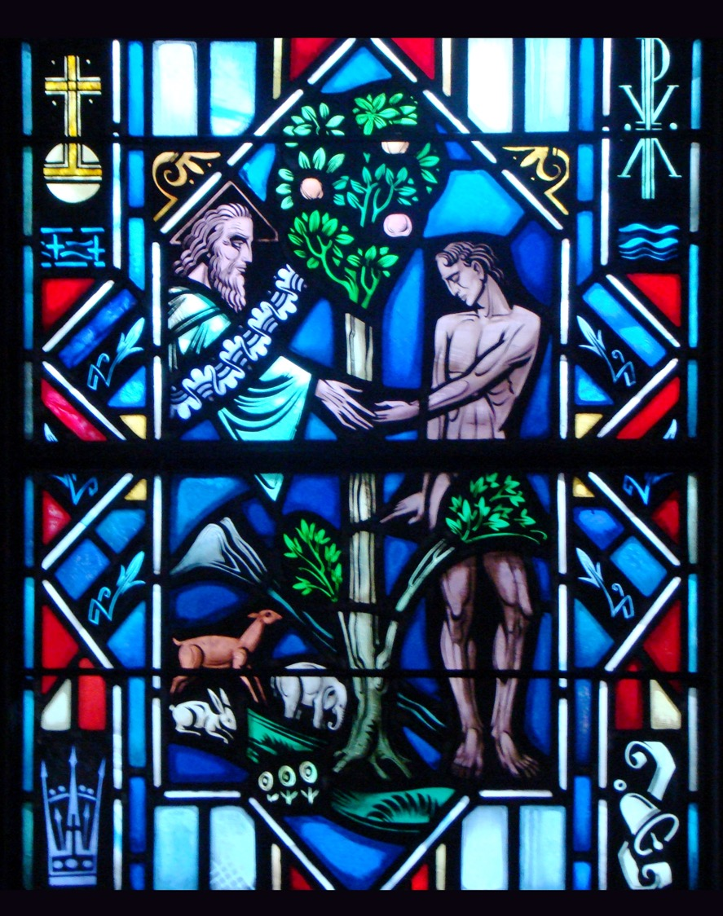
The Apostles’ Creed
First Article – Part 2

Slide 2
Review
Worksheet

Slide 3
Activity
Break into groups.
Discuss and write down the “hands, channels, and means” through which you received:
The food on your table.
The clothes on your back.
The home that you live in.

Slide 4
1st Article of the Creed
It’s easy to think that God the Father just created the universe and then stepped back and let it go. In fact, there are many out there who believe that God isn’t really involved in His creation much today – as if He were a watchmaker who built a watch, got it running and left it alone.
That isn’t what the Bible teaches about how God works.

Slide 5
1st Article of the Creed
Specific Scriptural Examples
God took care of Noah and his descendants
(Gen. 9:1-3).
God took care of Israel in the wilderness
(Deut. 8:3-4)
God took care of Elijah, the widow, and her son during the famine (1 Kings 17)
What are some others?

Slide 6
1st Article of the Creed
God cares and provides for His entire creation, which includes:
His entire nonhuman creation.
Matt. 6:26 – Look at the birds of the air: they neither sow nor reap nor gather into barns, and yet your heavenly Father feeds them.
All people, even those who fail to acknowledge Him.
Matt. 5:45 – For He makes His sun rise on the evil and on the good, and sends rain on the just and on the unjust.
He provides for those who are His children in Christ.
Phil. 4:19 – And my God will supply every need of yours according to His riches in glory in Christ Jesus.

Slide 7
1st Article of the Creed
God provides for our body and life:
Food and drink to give us energy, health, and joy.
Psalm 104:14-15 – You cause the grass to grow for the livestock and plants for man to cultivate, that he may bring for food from the earth and wine to gladden the heart of man, oil to make his face shine and bread to strengthen man’s heart.
Clothing and shoes for protection and for modesty.
Gen. 3:21 – And the LORD God made for Adam and for his wife garments of skins and clothed them.
House and home for shelter, security, and hospitality.
Psalm 68:6 – God settles the solitary in a home.
Families and also friends to help us bear one another’s burdens.
Proverbs 18:22 – He who finds a wife finds a good thing and obtains favor from the LORD.
Land and animals (that is, work and livelihood).
Psalm 104:23 – Man goes out to his work and to his labor until evening.

Slide 8
1st Article of the Creed
God protects us from danger and evil.
Psalm 121:2, 7 – My help comes from the LORD, who made heaven and earth…The LORD will keep you from all evil; He will keep your life.
God is at work in all things for our good.
Romans 8:28 – And we know that for those who love God all things work together for good.

Slide 9
Activity
On a piece of paper write down an individual that God uses to provide, care, and protect you (i.e. doctors, firefighters, etc.)
Break into two teams.
Select an individual from your team to draw this individual. The others will have to guess what that person is drawing.
Each correct answer is a point.
The team with the most points win.

Slide 10
Suffering
If God is really involved in caring for His creation, why do so many people suffer so much? The Bible provides the basic answer to this question.
Adam and Eve brought evil and suffering into the world by rebelling against God. Sinful activity continues to cause tremendous suffering throughout the world.
Romans 5:12 – As sin came into the world through one man,…death spread to all men because all sinned.
God punished human rebellion by cursing the earth. Even thought the earth sustains life, God’s judgment also evident in storms, earthquakes, diseases and so forth.
Gen. 3:17 – Cursed is the ground because of you…

Slide 11
Suffering
Therefore, we need to repent of our sin, trust God’s promise of forgiveness in Christ, care for those who suffer and pray for God’s restoration of all things when Christ comes again.
Read Luke 13:1-5

Slide 12
Suffering
In regards to suffering:
In some cases, we bring the suffering upon ourselves as a consequence of our sins.
2 Samuel 12 reveals how have King David committed adultery and murder, his son dies.
In many cases, we don’t know why God allows some to suffer more than others. Those reason remain hidden in God.
Isaiah 55:8-9 – For My thoughts are not your thoughts, neither are your ways My ways, declares the Lord.

Slide 13
Suffering
The chief example is Christ’s death on the cross. Those who saw Jesus suffer weren’t at the time aware of God’s great and loving purpose behind the cross.
Because of Christ’s death on the cross, sin and death and the devil doesn’t have the final say. God is working out all things for His gracious purpose and for the well-being of His Church.

Slide 14
The Small Catechism
I believe in God, the Father Almighty, Maker of heaven and earth.
What does this mean? I believe that God has made me and all creatures; that He has given me my body and soul, eyes, ears, and all my members, my reason and all my senses, and still takes care of them.
He also gives me clothing and shoes, food and drink, house and home, wife and children, land, animals, and all I have. He richly and daily provides me with all that I need to support this body and life.
He defends me against all danger and guards and protects me from all evil.
All this He does only out of fatherly, divine goodness and mercy, without any merit or worthiness in me. For all this it is my duty to thank and praise, serve and obey Him.
This is most certainly true.

Slide 15
The Small Catechism
God’s love and grace alone motivated Him to create and care for His creation. There’s nothing that we did to earn His favor. Yet, it’s right and proper for creatures to respond to the gifts of their Creator in word (thanks and praise) and deed (serve and obey).
Thank: Expressing our gratitude for all that He has done.
Praise: Proclaiming and praising His works to others.
Serve: When we use all His gifts within our vocation for the well-being of our neighbor.
Obey: Following His commands.

Slide 16
Questions?

