Slide 1
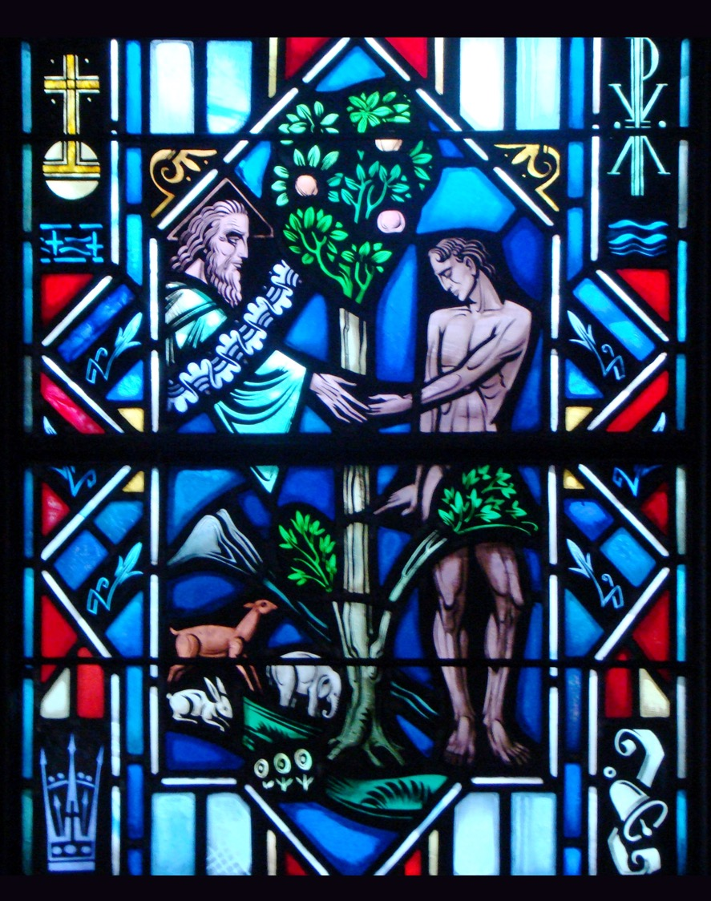
The Apostles’ Creed
First Article – Part 1

Slide 2
Review
The Commandments

Slide 3
Introduction
Q: Some people say that it doesn’t really matter what you believe about anything. It’s all equally valid. What do you think?
A: Scripture reveals that not everything is equally valid:
There’s only one God. “Hear, O Israel: The Lord our God, the Lord is one…” (Deut. 6:4)
God is one in three persons. “…baptizing them in^{[b]} the name of the Father and of the Son and of the Holy Spirit…” (Matt. 28:19)
Jesus is the only way to God. “Jesus said to him, ‘I am the way, and the truth, and the life. No one comes to the Father except through me.’” (John 14:6).
IT MATTERS WHAT YOU BELIEVE!

Slide 4
Introduction
Q: What is a creed?
A: A creed is a statement of faith, a statement of what you believe. The English word creed comes from the Latin word credo – “I believe.”
Is…
“I believe in God, the Father Almighty,” a creed?
“Deeds, not creeds,” a creed?
“No creed but the Bible,” a creed?

Slide 5
Introduction
Q: What creeds does the Christian Church confess?
A: The Apostles, The Nicene, and The Athanasian. Each creed clarified specific doctrinal controversies that came up throughout the church’s history.
SEE HANDOUT OF THE THREE ECUMENICAL CREEDS

Slide 6
Introduction
Q: Why do we use the Apostles’ Creed in the catechism?
A: It’s the creed commonly used in Baptism. The Apostles’ Creed is called such, not because it was written by the apostles themselves, but because it states briefly the doctrine that God gave through the apostles.
Each creed reveals what we believe, teach, and confess about who God is and what He has done and what He continues to do.

Slide 7
Matthew 3:13-15
Read Matthew 3:13-15
Q: Who baptized Jesus?
A: John the Baptist (v.13).
Q: How did John respond to Jesus’ request to be baptized?
A: Surprised. He believed Jesus should baptize him (v.14).
Q: Did Jesus change His mind and baptized John?
A: No. ”Jesus answered him, ‘Let it be so now, for thus it is fitting for us to fulfill all righteousness.’” (v.15).

Slide 8
Matthew 3:13-15
It seems strange that Jesus needed to be baptized.
Jesus was without sin. Baptism is meant for sinners.
Jesus receiving baptism was not for Himself but for us.
This was Jesus’ first public step toward the cross.
Receiving the baptism of repentance meant for sinners, Jesus was taking His place alongside of us, under our load of sin.
Jesus received baptism not just as a “holy person” but as the holy person sent to save all us un holy ones.

Slide 9
Matthew 3:16-17
Read Matthew 3:16-17
Q: What happened after Jesus is baptized? Who is revealed?
A: The other two persons of the Holy Trinity.
The Spirit of God, or the Holy Spirit, descends like a dove (v.16).
The Father speaks, “This is my beloved son, with whom I am well pleased” (v.17).

Slide 10
Matthew 3:16-17
The Holy Trinity isn’t a mathematical formula that can be explained.
The Holy Trinity is the one true God, living and active and full of love for us sinners.
When Jesus takes His first public steps towards the cross He isn’t alone.
The Father and the Holy Spirit are in total agreement with the work He is undertaking.

Slide 11
The Holy Trinity
A few texts that speak to the identity of God as He has revealed it to us:
One God (Deuteronomy 6:4)
No other God (Isaiah 45:21)
None like Him (Isaiah 46:8-9)
The Maker of all things (Isaiah 44:14)
We are to worship no one else (Matthew 4:10
Jesus make all things (John 1:3)
Receives the same honor as the Father (John 5:22)
Is called God (John 1:1, 14)
The Holy Spirit is called God (Acts 5:1-5)
The Holy Spirit Speaks (1 Timothy 4:1)
Scripture reveals that the Father is God, the Son is God and the Holy Spirit is God. Yet, there are not three Gods but one God.

Slide 12
1st Article of the Creed
The Creed is divided into three articles. They’re usually referred to as Creator, Redeemer, and Sanctifier.
The reason for this is Scripture ordinarily speaks of the Father as creating us, the Son redeeming us, and the Holy Spirit Sanctifying us.
Yet, in their relationship to one another, the three persons find their unity as one divine being called God. The Father, Son, and Spirit are alike almighty, alike Creator, alike Redeemer.

Slide 13
1st Article of the Creed
I believe in God, the Father Almighty, Maker of heaven and earth.
Q: Why is the First Person of the Trinity called God the Father. See John 3:16, Galatians 4:4-6, Acts 17:28-29
A: He is:
the eternal Father of the Son of God, Christ our Savior (John 3:16).
The gracious Father of all Christians, having adopted us in Christ (Galatians 4:4-6).
Graciously providing for all people “as a kind Father” (Acts 17:28-29).

Slide 14
1st Article of the Creed
I believe in God, the Father Almighty, Maker of heaven and earth.
Q: What is included in the phrase “heaven and earth?”
A: The only one who made heaven and earth can rightly be called God. God created, out of nothing, everything that exists.

Slide 15
Genesis 1:1-5
Read Genesis 1:1-5
Questions:
Who alone was ”in the beginning?”
What did He do?
From what did God create all things?
Why is it important to understand that God created all things out of nothing?
Are all three persons of the Trinity involved in creation?
Are there parallels between Genesis 1:1-5 and John 1:1-5,10-14,18?

Slide 16
The Small Catechism
I believe in God, the Father Almighty, Maker of heaven and earth.
What does this mean? I believe that God has made me and all creatures; that He has given me my body and soul, eyes, ears, and all my members, my reason and all my senses, and still takes care of them.
He also gives me clothing and shoes, food and drink, house and home, wife and children, land, animals, and all I have. He richly and daily provides me with all that I need to support this body and life.
He defends me against all danger and guards and protects me from all evil.
All this He does only out of fatherly, divine goodness and mercy, without any merit or worthiness in me. For all this it is my duty to tank and praise, serve and obey Him.
This is most certainly true.

Slide 17
The Small Catechism
Activity
Take a few minutes to write down what does it mean that God made you, that God made all creatures.
Possible Answers:
God made the universe and everything in it.
Nothing exists apart from God’s creation.
I’m a creature of God. My life is a gift from Him. I’m accountable to Him.
Ever person (regardless of age, race, sex, ethnicity) receive life from God

Slide 18
The Small Catechism
Activity
Take a few minutes to write down what does it mean that God has given you your body and soul, eyes, ears, and all your members, your reason and all your senses ands till takes care of them.
Possible Answers:
I’m not just a body or just a soul but am both which God breathed life into.
He’s made me specifically either a male or female.
Those things such as eyes and ears help me relate to God and other people.
God doesn’t just create the heavens and the earth, but continues to be active in His creation.

Slide 19
Questions?

