Slide 1
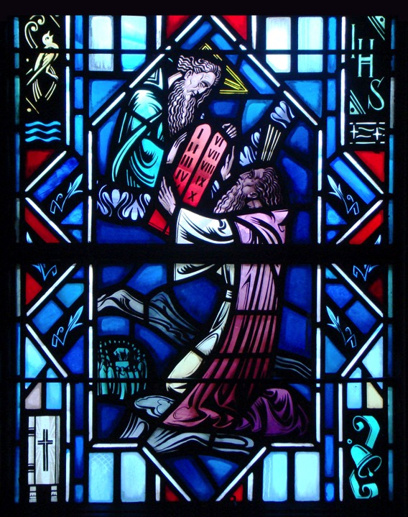
The Ten Commandments
The Close of the Commandments
Notes:
Opening Prayer:
Invocation
Ten Commandments
Apostle’s Creed
Lord’s Prayer
Sing LSB 581 (st. 1, 2, 11, 12)

Slide 2
Introduction
Have you ever heard anyone say things such as:
God doesn’t really care what I do.
Why do Christians judge?
If God really loves me, He want me to be happy and I do what makes me happy?
Q: What’s wrong with these comments? What might you say to them?
A: These statements are false and harmful. God does care about what we do and judges us. He lays out for us what He commands in the Ten Commandments.

Slide 3
Review
The Ten Commandments:
Summarize God’s Law, namely, His good and loving will for the lives and well-being of all people within His creation.
Matthew 22:36-40
“‘Teacher, which is the great commandment in the Law?’ And he said to him, ‘You shall love the Lord your God with all your heart and with all your soul and with all your mind. This is the great and first commandment. And a second is like it: You shall love your neighbor as yourself. On these two commandments depend all the Law and the Prophets.’”

Slide 4
Review
God’s will for our lives:
Love God (Commandments 1-3)
Love our neighbor (Commandments 4-10)
God gave His Law to Us:
Romans 2:14-16 – Law is written on their hearts, conscience also bears witness.
Exodus 20:1-17 – God gives the Ten Commandments into Israel.

Slide 5
Close of the Commandments
When we speak of God’s Law, we see it used in three different ways:
Curb – Helps keep order in the world. Leads people to do what is right by threatening punishment for disobedience and promising reward for obedience (See 1 Timothy 1:9-10).
Mirror – Shows us our sinful selves and condemns our sin (See Rom. 3:20).
Guide - Guides Christians to live God-pleasing lives in thoughts, words, and deeds (See Psalm 119:105)

Slide 6
Close of the Commandments
Q: Why is the second use of the Law so important?
A: It shows that we all have sinned and cannot keep God’s commandments. The Law always accuses.
Read:
Matthew 5:48
Romans 3:23
James 2:10

Slide 7
Close of the Commandments
Matthew 5:48
- God demands perfection in thought, word and deed.
Romans 3:23
- Every human aside from Christ falls short and all have sinned. Outwardly some appear closer than others but no one can live a perfect holy life.
James 2:10
- Whoever keeps the whole law but fails in one point has become accountable for all of it.

Slide 8
Close of the Commandments
Question
Is there any commandment that you haven’t broken? Have you been able to keep all ten perfect in thought, word and deed?
No! We’re sinners!

Slide 9
Close of the Commandments
Q: What is sin?
A: Sin is humanity’s fallen condition. We’re turned away from God and are unable to fear, love, and trust in Him.
Q: How did sin enter God’s good creation?
A: The devil brought sin into the world by tempting Adam and Eve, who willingly yielded to the temptation (Gen. 3:1-6).
Q: How did Adam and Eve’s disobedience affect us?
A: The entire human race also fell into sin. This is called original or inherited sin. Psalm 51:5, “Behold, I was brought forth in iniquity, and in sin did my mother conceive me.”

Slide 10
Close of the Commandments
Since original sin affects every human creature, it means that every person born:
Is without the ability to fear and love God (See 1 Cor. 2:14).
With an endless desire to sin – we are enemies of God (See Gen. 8:21).
Deserving God’s temporal and eternal death sentence (See Romans 5:12).
Enslaved in a lifelong sinful condition from which we cannot fee ourselves (See John 8:34)

Slide 11
Close of the Commandments
The Consequences:
He says, “I, the LORD your God, am a jealous God, punishing the children for the sin of the fathers to the third and fourth generation of those who hate Me, but showing love to a thousand generations of those who love Me and keep My commandments” (Ex. 20-5-6).

Slide 12
Close of the Commandments
God is a jealous God. He demands that we give all honor and glory to Him alone. As the 1st Commandment reveals, that we fear, love and trust in Him alone.
Disobedience provokes God to punish sin. This punishment include both earthly punishments and physical death and eternal damnation in hell.

Slide 13
Scripture
Read Matthew 27:32-46
Why read this text?
How severely will God punish those who transgress His Law?
Is there anything we can do to save ourselves?

Slide 14
Small Catechism
What does God say about all these commandments?
He says, “I, the LORD your God, am a jealous God, punishing the children for the sin of the fathers to the third and fourth generation of those who hate Me, but showing love to a thousand generations of those who love Me and keep My commandments.” (Ex. 20-5-6)
Notes:
1) The Close of the Commandments: Recite together.

Slide 15
The Small Catechism
What does this mean?
God threatens to punish all who break these commandments. Therefore, we should fear His wrath and not do anything against them. But He promises grace and every blessing to all who keep these commandments. There, we should also love and trust in Him and gladly do what He commands.
Notes:
1) The Close of the Commandments: Recite together.

Slide 16
Small Catechism
Q: Why did Luther list the Ten Commandments first in the Small Catechism?
A: Luther places the Ten Commandments at the beginning of the catechism since it functions primarily as a diagnostic tool, helping us to arrive at a true knowledge and understanding of oneself. Since we lack the power and ability to keep the Ten Commandments, it ultimately reveals our need for faith, which is revealed in the Apostles’ Creed and Lord’s Prayer.

Slide 17
Ten Commandments in the Liturgy

Slide 18
Divine Service
Name three places in the Divine Service where we see a reference to the Ten Commandments
Confession
The Kyrie
Sermon
Lord’s Prayer

Slide 19
Divine Service
The Kyrie
Kyrie Eleison is Greek for, “Lord, have mercy upon us.”
The Kyrie is a cry, a prayer for God to have mercy on us sinners.
There is nothing we can do but call upon him for the forgiveness of sins, life, and salvation that we need.

Slide 20
Questions?
Notes:
Prayer: Almighty and everlasting God, through Your Son You have promised us forgiveness of sins and everlasting life. Govern our hearts by Your Holy Spirit that in our daily need, and especially in all time of temptation, we may seek Your help and, by faith in Your Word, obtain all that You have promised; through Jesus Christ, our Lord. Amen.

