Slide 1
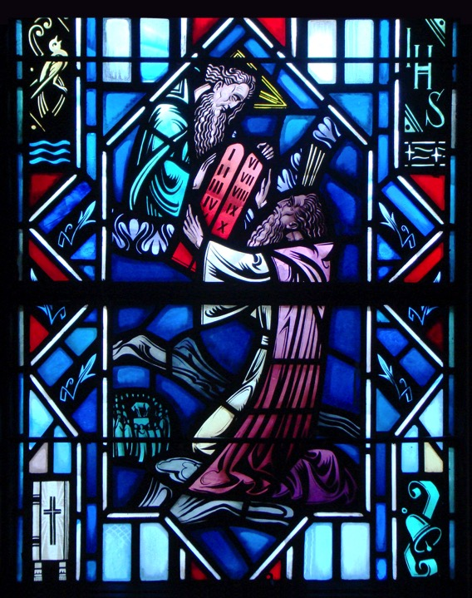
The Ten Commandments
The Seventh, Ninth, and Tenth Commandments

Slide 2
Review
Sixth and Eighth Commandments Worksheet

Slide 3
7th Commandment
You shall not steal

Slide 4
Activity
Write down some ways that you can help protect and care for the earthly goods of your neighbor.
We know that life is not about money. But we all know money and possessions are still important. Write down why money and possessions are still important.
Q: What are some ways in which we are to not take what belongs to our neighbor and way in which we are to look after our neighbor’s earthly things?
A: This can include being lazy at work. Cheating or bending the rules. Being a lookout for someone while they steal.

Slide 5
God’s Gift of Property
A few questions to consider before we continue:
Have I been lazy or doing a poor work in school, or only work hard when the teacher is around?
Have I worked for myself rather than for Christ and for the benefit of my neighbor?
Have I stolen anything that God hasn’t entrusted to me?
Have I wasted time, food, and money?
These are a few questions we need to consider when discussing the 7th Commandment. In the 7th Commandment we discuss God’s gift of property. God blesses us in this life with property and goods in order that we might serve our family and neighbor with His gifts.

Slide 6
God’s Gift of Property
The Large Catechism says:
After the commandment about you personally and your spouse, next comes the commandment about temporal property. God also wants property protected. He has commanded that no one shall take away from, or diminish, his neighbor’s possessions…

Slide 7
Luke 19:1-10
Q: Who is Zacchaeus?
A: He is the chief tax collector in Jericho. He was seeking to see Jesus ‘v.2.’ He was rich, which indicated he used is position for his own benefit. He charged more than what was required. He stole from people.
Q: What was seeking?
A: He was seeking to see who Jesus was ‘v.3.’
Q: What did Jesus say?
A: Come down. I must stay at your house today ‘v.5’. Jesus has found the seeker and extends mercy to the despised tax collector by asking to stay with him.

Slide 8
Luke 19:1-10
Q: What were the people saying?
A: He has gone into be the guest of a man who is a sinner ‘v7.’ Some thought that for Jesus to eat with such a man was to become a partner with him in his sins.
Q: What does Zacchaeus promise to do?
A: Half of his goods he will give to the poor. If he defrauded (misled, tricked) anyone of anything, he will restore it fourfold ‘v8.’

Slide 9
Luke 19:1-10
Q: What is this a sign of?
A: His words and actions are a sign of repentance. The word of God as work in him repentance.
Q: What does Jesus say to him?
A: Salvation has come ‘9’. Jesus has brought Zacchaeus out of sin and into life! Jesus came to seek the lost. Zacchaeus has been found.

Slide 10
The Small Catechism
The Seventh Commandment:
You shall not steal.
What does this mean? We should fear and love God so that we do not take our neighbor’s money or possessions, or get them in any dishonest way, but help him to improve and protect his possessions and income
Where do we see the First Commandment?
Where do we see the negative command?
Where do we see the positive command?

Slide 11
The Small Catechism
You shall not steal.
What does this mean? We should fear and love God so that we do not take our neighbor’s money or possessions, or get them in any dishonest way, but help him to improve and protect his possessions and income.
Terms
Stealing: Taking for yourself what God has not given or provided, withholding support from those in need and failing to take care of your responsibilities with the gifts God has given you.
Property: All the material gifts which God has given you over which He has appointed you a steward.
Stewardship: The use of all that you are and have in service to God and your neighbor.

Slide 12
The 7th Commandment
What does God forbid us to do in the 7th Commandment?
The wicked borrows but doesn’t pay back, but the righteous is generous and gives (Psalm 37:21).
Let the thief no longer steal, but rather let him labor, doing hones work with his own hands, so that he may have something to share with anyone in need (Eph. 4:28).

Slide 13
The 7th Commandment
What does God commands us to do in the 7th Commandment?
So whatever you wish that others would do to you, do also to them (Matt. 7:12).
Let each of you look not only to his own interest, but also to the interest of others (Phil 2:4).

Slide 14
The 7th Commandment
Final thoughts:
In the 7th Commandment we learn about God’s gift of possessions.
We are to look out for our neighbor and his earthly gifts that God has given him.

Slide 15
9^{th &} 10th Commandments
You shall not covet your neighbor’s house.
You shall not covet your neighbor’s wife, or his manservant or maidservant, his ox or donkey, or anything that belongs to your neighbor.

Slide 16
Activity
How do you define coveting? How do you define contentment? To help you with this look up both James 4:1-2 and Hebrews 13:5-6.
Answer:
Coveting is the sinful desire in our hearts to acquire for ourselves anything that belongs to our neighbor. It is also the desire to draw away from our neighbor for our own benefit anyone who is important to our neighbor.
Contentment is being satisfied and thankful with what God has provided us. This also includes helping others to retain what God has given them.

Slide 17
God’s Gift of Contentment
Coveting is the result of sin:
Sin…produced in me all kinds of covetousness (Rom. 7:8).
Out of the heart come evil thoughts… (Matt. 15:19).
In the 9th & 10th Commandments we’ll discuss God’s gift of contentment.
9th - Contentment with those inanimate possession items. (i.e. - Games, toys, clothes, In the future a house or car)
10th - Contentment with individuals. (Animate objects. Those who are alive - a spouse, friends, pets, etc.)
Where the 7th Commandment talks about taking those things that don’t belong to us. The 9th & 10 Commandments focus on the sinful desire of the heart. This can lead us to breaking other commandments.

Slide 18
9th Commandment
Scripture tells us about the 9th Commandment
(Read 1 Kings 21:1-15)
Q: Is it a coveting for Ahab to seek out food?
A: No. God encourages us to seek His blessings of food, shelter, etc. Ahab was offering a fair price to buy it, also offered a better vineyard. It is sinful is if knew this was Naboth’s inheritance, something he couldn’t sell.
Q: What was Naboth’s response?
A: No, the Lord forbid that I should give you the inheritance of my fathers ‘v.3’
Q: What was Ahab’s reaction?
A: Answer: Vexed (angry) and sullen (gloomy). This is where we see the sin of Ahab.

Slide 19
9th Commandment
Q: What did Ahab’s wife Jezebel do? What were her sins? What Commandments did she break?
A: v.8 - Wrote letters in Ahab’s name to elders (8th Commandment - lying to elder, deceiving her husband). v.13 - Worthless men opposite Naboth and bring a charge against him (8th Commandment - spoke falsely of Naboth). v.13 - stoned Naboth to death with stones (5th Commandment - murdered).
Q: Did Ahab eventually take possession of the vineyard?
A: Yes, v.16. For this God will condemn both Ahab and his wife Jezebel.

Slide 20
The Small Catechism
The Ninth Commandment:
You shall not covet your neighbor’s house.
What does this mean? We should fear and love God so that we do not scheme to get our neighbor’s inheritance or house, or get it in a way which only appears right, but help and be of service to him in keeping it.
Where do we see the First Commandment?
Where do we see the negative command?
Where do we see the positive command?

Slide 21
The Small Catechism
The Ninth Commandment
Q: What does God forbids us to do in the 9th Commandment?
A: God forbids every sinful desire to get our neighbor’s possessions openly or by trickery. “If we have food and clothing, with these we will be content. But those who desire to be rich fall into temptation…”(1 Tim. 6:8-9).
Q: What does God commands us to do in the 9th Commandment?
A: We should be content with what God has given us and assist our neighbor in keeping what God has given that person. “Keep your life free from love of money, and be content with what you have, for He has said, “I will never leave you nor forsake you” (Hebrews 13:5).

Slide 22
10th Commandment
Scripture tells us about the 10th Commandment
(Read 2 Samuel 11:2-4)
Q: Where did David first sin?
A: Lusted after the beautiful woman on the roof. He sent men to inquire more information about the woman.
Q: Who was this woman? To whom did she belong?
A: Bathsheba, the daughter of Eliam, the wife of Uriah the Hittite?
Q: How did David break the 10th commandment?
A: He desired his neighbor’s spouse. Someone that was already married. David sent messengers and took her, and she came to him, and he lay with her. David goes onto break the 6th Commandment by committing adultery and the 5th commandment by murdering Uriah the Hittite.

Slide 23
The Small Catechism
The Tenth Commandment
You shall not covet your neighbor’s wife, or his manservant or maidservant, his ox or donkey, or anything that belongs to your neighbor
What does this mean? We should fear and love God so that we do not entice or force away our neighbor’s wife, workers, or animals, or turn them against him, but urge them to stay and do their duty.
Where do we see the First Commandment?
Where do we see the negative command?
Where do we see the positive command?

Slide 24
The Small Catechism
The Tenth Commandment
Q: What does God forbids us to do in the 10th Commandment?
A: God forbids every sinful desire to take from our neighbor that person’s spouse or workers. “Take care, and be on your guard against all covetousness, for one’s life doesn’t consist in the abundance of his possessions” (Luke 12:15).
Q: What does God commands us to do in the 10th Commandment?
A: To be content with the helpers God has given us. To encourage our neighbor’s helpers to be faithful to our neighbor. “Let each of you look not only to his own interests, but also to the interests of others” (Phil. 2:4).

Slide 25
Additional Thoughts
Q: Is all wanting, desiring, and ambition sinful?
A: No.
God encourages us to seek His blessings of food, shelter, good jobs, health, success for ourselves and our family.
Such desire becomes sinful when our seeking and desiring leads us to be ungrateful for what we have and dissatisfied with what God has provided us.
This sinful desire can lead us to breaking other commandments (i.e. - stealing, adultery, murder, etc).

Slide 26
Questions?

Slide 27
Ten Commandments in The Small Catechism
First Chief Part

