Slide 1
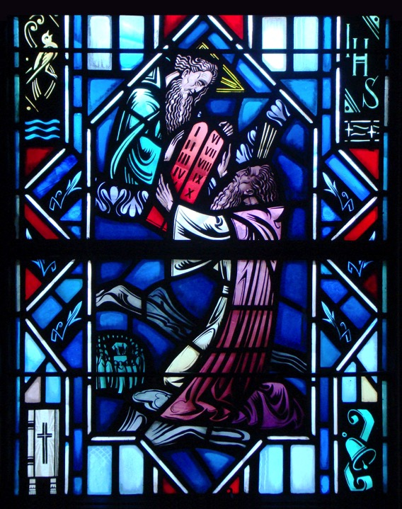
The Ten Commandments
The Sixth & Eighth Commandments

Slide 2
Review
Second & Third Commandment Worksheet

Slide 3
6th Commandment
You shall not commit adultery.

Slide 4
Introduction
The 5th through the 10th Commandments are all to show that we must avoid doing any kind of harm to our neighbor.
The 6th Commandment deals with the person nearest to him - spouse.
In the 6th Commandment we will hear about God’s gift of marriage.

Slide 5
Genesis 1:26-28
Q: Who created man and woman, and in whose image did He create them?
A: God. He created us in His image. Man would reflect God’s character.
God has created each one of us as either male or female.
Q: What purpose did God create man and woman?
A: Be fruitful and multiply and fill the earth - that is to bring forth children.
Subdue it and have dominion - man and woman would be God’s representatives on earth.

Slide 6
Genesis 2:18-24
Q: Once God created man, God describes something as “not good.” What was it? What did God do about it?
A: It is not good that man should be alone.
God created a helper - woman. Someone in God’s image who would complement man, complete him in a sense.

Slide 7
Genesis 2:18-24
Q: When a man leaves his father and his mother and hold fast to his wife, what picture do we see?
A: Marriage!
At the time of creation God already institutes His gift of marriage. A one flesh union between one man and one woman. This lifetime union is for the mutual help and joy, and the bringing forth of children.

Slide 8
Introduction to Genesis 39
In the 6th Commandment we will hear about God’s gift of marriage. Yet, how many of you are married?
Does this mean you don’t have to worry about the 6th Commandment right now? No!
In the 6th Commandment we will hear how our bodies are gift from God, and how there is a proper use of our bodies whether we are married or not.

Slide 9
Genesis 39
Q: What do you know about Joseph?
A: His father was Jacob. Mother was Rachel. He was one of twelve brothers. He was sold into slavery. He became a servant in Potiphar’s house.
Q: Who is Potiphar?
A: Captain of the Guard for Pharaoh.
Q: Who was with Joseph in Egypt?
A: The LORD. Joseph was faithful to God in all that he did for Potiphar. God directed all that Joseph did and gave him success.

Slide 10
Genesis 39
Q: Did Potiphar entrust everything to Joseph? What was the one thing not entrusted to him?
A: Joseph was faithful to his master and in all that he did for Potiphar. As a result, Potiphar entrusted everything to him except for his wife.
Q: Where do we first see sin in this account?
A: Potiphar’s wife. “Casting her eyes” (v. 7) on Joseph, and desiring lie with him (v.7), Potiphar’s wife is lusting and coveting a man God had not given to her as a husband.
Notice, there’s no self-sacrificial love in her desire to be with Joseph. The love here is selfish and self-centered. Potiphar’s wife is out to satisfy her own sinful desires.

Slide 11
Genesis 39
Q: Was this a one time event?
A: No. Verse 10 says day after day she spoke to Joseph.
Q: How did Joseph respond to these sinful advances?
A: “He refused” (v. 7). He would not sin against the 6th Commandment.
“Behold, because of me my master has no concern about anything in the house, and he has put everything that he has in my charge. He is not greater in this house than I am, nor has he kept back anything from me except you, because you are his wife. How then can I do this great wickedness and sin against God?” (v. 8-9).

Slide 12
Genesis 39
Q: Who does Joseph say he'll sin against?
A: God. This emphasizes the fact that every sin is a sin against God - the 1st Commandment. To engage in this act of adultery would deny everything he believed about God - how God has loved him.
Even though Joseph suffered in his life, Joseph has been a recipient of this love. God hasn't forsaken him for Christ's sake.

Slide 13
Genesis 39
Q: Does this deny the fact Joseph would have sinned against Potiphar?
A: No! If he did lie with Potiphar's wife, Joseph would have sinned against Potiphar.
Yet, Joseph's chastity was a wonderful confession of faith in the God of love. His chastity served Potiphar, preserving his marriage. Joseph did what was best for his neighbors, both Potiphar and his wife. He cared more about them than himself.

Slide 14
Genesis 39
Q: What other sin do we see towards the end of this narrative?
A: Potiphar's Wife falsely accused Joseph of raping her. Yet, Joseph did not retaliate. He quietly suffered. He continues to support both Potiphar and his wife.
Is this not what Christ did for His church? Christ sacrifices himself on the cross for the church. He opened not His mouth against false accusations and took on the sin and suffered her punishment.

Slide 15
Ephesians 5
Read Ephesians 5:22-33
A husband loves his wife like Christ loved the church. He is to lay his life down for her.
A wife is to submit to the husband as the church does to the Lord.
Our teaching on marriage is important for this is actually a picture of Christ and His bride the church.

Slide 16
The Small Catechism
The Sixth Commandment:
You shall not commit adultery.
What does this mean? We should fear and love God so that we lead a sexually pure and decent life in what we say and do, and husband and wife love and honor each other.
Where do we see the First Commandment?
Where do we see the negative command?
Where do we see the positive command?

Slide 17
The Small Catechism
We can break the sixth when we misuse our bodies or misuse other peoples by our deeds and even our thoughts.
Jesus says, “But I say to you that everyone who looks at a woman with lustful intent has already committed adultery with her in his heart” (Matthew 5:28).

Slide 18
The Small Catechism
Marriage between one man and one woman is God’s gift to us.
Outside of marriage, your body is God’s gift to you. God formed you. You are wonderfully made. (Psalm 139:13-14).
Until marriage, your body is your own and not to be shared with others until marriage. We fear and love God when we treat our bodies as set apart for the purpose He intended.

Slide 19
8th Commandment
You shall not give false testimony against your neighbor.

Slide 20
Introduction
Have:
You ever been entrusted to keep the secret of another?
You ever given your sibling or friend a compliment for doing something good?
Your parents ever said to you, “Tell me the truth?”
Your siblings ever blamed you for something you didn’t do or did you blame them for something they didn’t do?

Slide 21
Introduction
In these instances we’re dealing with the 8th Commandment.
The 8th Commandment focuses on God’s good gift of a good name and reputation – how other people view you. You and others should be viewed in the best possible light.
God wants you to stand upright in character before your family and friends. A good name or reputation is important so that each of us may enjoy the trust and respect of others.

Slide 22
James 3:1-12
Q: What is a bit? (v.3)
A: A metal piece that goes into the mouth of a horse so the rider can direct the horse where to go.
Q: What is a rudder? (v.4)
A: It is a flat piece, usually of wood, metal, or plastic, hinged vertically near the back of a boat or ship and is used for steering.

Slide 23
James 3:1-12
Like a bit for a horse and a rudder for a ship, our tongues, while small, are extremely powerful.
The tongue can affect our entire bodies and others.
The words we speak, which the tongue helps form, can be used to help but also can do great harm.
James goes onto explain its power.

Slide 24
James 3:1-12
Q: How many of you have dogs or other animals? Are you able to teach them to do tricks?
A: James writes that every animal - every kind of beast and bird, of reptile and sea creature, can be tamed and has been tamed by mankind.
Q: How many people have been able to tame the tongue, this small member? (v.8)
A: no human being can tame the tongue.

Slide 25
James 3:1-12
Q: How is the tongue described in this passage?
A: It is described as:
A small member, yet it boast of great things (v.5).
It is like a small fire that can set a forest ablaze (v.5).
Something so small can do great damaging
Stains the whole body (v.6).
The tongue defiles makes unclean our body.
It is a restless evil, full of deadly poison (v.8).
Shows the extent of the harm the tongue can do to ourselves and others.

Slide 26
James 3:1-12
These are not good descriptions.
The tongue is often used to speak wrongly of others. With one little word we can hurt those people around us - parents, siblings, friends. Saying hurtful things about another is like scattering feathers – gossip is easy to spread and impossible to recover.
These words reflect our sinful human nature as:
Even though we use our tongue to bless our Lord and Father
Yet at the same time we are able curse our fellow brothers and sisters in Christ.

Slide 27
Small Catechism
The Eighth Commandment:
You shall not give false testimony against your neighbor.
What does this mean? We should fear and love God so that we do not tell lies about our neighbor, betray him, slander him or hurt his reputation, but defend him, speak well of him, and explain everything in the kindest way.
Where do we see the First Commandment?
Where do we see the negative command?
Where do we see the positive command?

Slide 28
Forbidden
God forbids us to tell lies about our neighbor, that is to lie about, lie to, or withhold the truth from our neighbor.
See Matthew 26:59-61
Q: What were the chief priest seeking? What did they want to do to Jesus? How were they breaking the 8th Commandment?
A: Telling lies. Saying things that Jesus didn’t do or say.

Slide 29
Forbidden
God forbids us to betray our neighbor, that is to reveals our neighbor’s secrets.
See Proverbs 11:13, “Whoever goes about slandering reveals secrets, but he who is trustworthy in spirit keeps a thing covered.”
Q: Can you tell me of an instance in the Bible where someone betrayed another?
A: Judas betrayed Jesus - Matt. 26:14-16
Spreading rumors, going behind our neighbors back to hurt his name.

Slide 30
Commanded
God commands that we should defend our neighbor, that is we should speak up for and protect him from lies.
See Proverbs 31:8-9, “Open your mouth for the mute, for the rights of all who are destitute. Open your mouth, judge righteously, defend the rights of the poor and needy.”
God commands that we should speak well of our neighbor, we should praise his good actions and qualities.
See 1 Samuel 19:4 - Jonathan spoke well of David.

Slide 31
Commanded
God commands that we put the best meaning on everything.
We should explain our neighbor’s actions in the best possible way.
We approach everything with the best intentions. We are to love our neighbor.

Slide 32
Questions?

