Slide 1
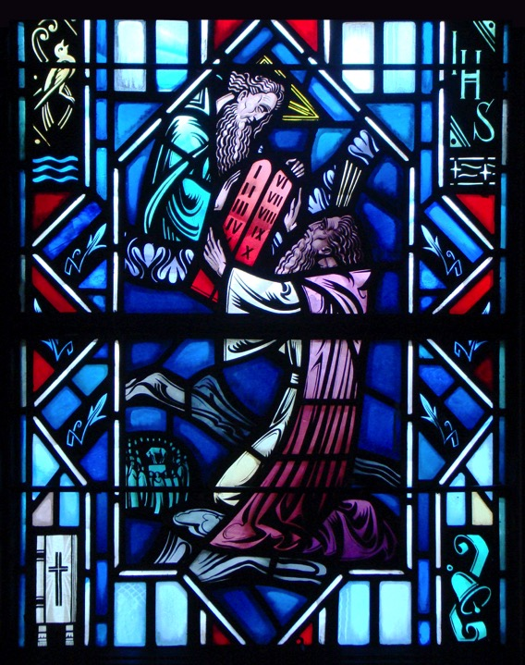
The Ten Commandments
The Fourth & Fifth Commandments

Slide 2
Review
Second & Third Commandment Worksheet

Slide 3
4th Commandment
Honor your father and mother.

Slide 4
God’s Representatives
The first three commandments focused on love for God, the remaining seven commandments focuses on love for neighbor. The Fourth Commandment has been called the “hinge” between the tables of the Law.
Q: The Fourth Commandments tells us we should honor our father and mother. Why does this commandment focus on parents?
A: They are God’s representatives through whom He bestows and nurtures life on earth. They are our closest neighbor.
Q: In what way are parents like God?
A: Love, provide, care, discipline us, etc.

Slide 5
God’s Representatives
Q: Does the Fourth Commandment focus only on parents?
A: No. God chooses to rule through agents in this world: parents and authorities. God created them to be His representatives for keeping order in this world. Their job is to act out God’s plan for His human creatures.

Slide 6
Activity
Break into Groups
Look up the following verses:
Proverbs 3:1-2
Romans 13:5-7
Ephesians 6:1-4
Ephesians 6:5-8
1 Timothy 5:17-19
Answer the following:
What authority is listed?
What does God expect?

Slide 7
Fourth Commandment
Turn to the Table of Duties in your Small Catechism.
Here, Luther lists various vocations which are categorized either by church, family, or government.
As Christians we can have multiple vocations. These vocations help us understand who is the authority.
Q: What are some of your vocations? Who is the authority? (Let’s write these on the board).
A: Examples: Child & Parent. Student & Teacher. Citizen & Government

Slide 8
Fourth Commandment
Q: Where does all authority come from?
A: God. “…there is no authority except from God…” (Rom. 13:1). These individuals are God’s representatives. They receive their authority from Him. Ultimately, love for authorities is related to love for God.

Slide 9
Fourth Commandment
Q: When do you or other people in your life, ‘bend the rules’ or disobey teachers or other authorities? When do you obey your parents?
Write down examples of both.

Slide 10
The Small Catechism
The Fourth Commandment:
Honor your father and mother.
What does this mean? We should fear and love God so that we do not despise or anger our parents and other authorities, but honor them, serve and obey them, love and cherish them.
Where do we see the First Commandment?
Where do we see the negative command?
Where do we see the positive command?

Slide 11
Fourth Commandment
We fear and love God by not despising our parents, guardians, or other authorities.
Despising means:
Looking down upon them or making fun of them (Proverbs 23:22).
Disobeying or rebelling against their God-given authority (Proverbs 15:20).

Slide 12
Fourth Commandment
We fear and love God by receiving and recognizing parents and authorities as His representatives. We do this by:
Honoring them (See Mark 7:10-12)
Serving and coming to the aid of our parents (See John 19:25-27)
Obeying our parents, pastors, teachers, employers, and government authorities.
Loving and cherishing our parents and other authorities on account of their God-given vocations.

Slide 13
Fourth Commandment
Additional Thoughts:
Q: What if my parents or other authorities poorly carry out their vocations from God? Do we not have to respect and honor?
A: No, in faith and obedience to God’s Word, we still respect them as those who have been given authority by God.
Q: Am I always to obey my parents and other authorities without question?
A: No. we must disobey them if they require us to disobey God’s Word. Acts 5:29 says, “We must obey God rather than men.”

Slide 14
Fourth Commandment
Read Luke 2:51
For 18 years of Jesus’ live, we don’t know what happened.
Scripture does tell us however, that he was submissive to His parents.
This is because His parents were God’s representatives on earth.
Its through them that God bestows and nurtures human life.

Slide 15
5th Commandment
You shall not murder

Slide 16
5th Commandment Intro.
The Fourth Commandment is the foundation for the Second Table of the Law.
Commandments 5-10 reveal different ways we love and serve our neighbors.
Q: Who is my neighbor? Is it only the person living next door to you?
A: No. A neighbor is anyone in need whom God has “placed in your path,” whether he is a friend or an enemy, a believer or an unbeliever.

Slide 17
God’s Gift of Life
The 5th Commandment tells us that we shouldn’t murder, but there is more to this than just taking a person’s life?
Q: How many of you have siblings and friends? Have you ever got angry at them? Have you always treated them with love?
A: We all have neighbors. Any thought or action of anger toward another is to break the 5th Commandment.
The Fifth Commandment ultimately focuses on God’s gift of life.

Slide 18
Genesis 4:1-16
Read
Question and Answer

Slide 19
Small Catechism
The Fifth Commandment:
You shall not murder
What does this mean? We should fear and love God so that we do not hurt or harm our neighbor in his body, but help and support him in every physical need.
Where do we see the First Commandment?
Where do we see the negative command?
Where do we see the positive command?

Slide 20
5th Commandment
When God tells us “You shall not murder,” it’s easy to simply respond, “Well, I haven’t killed anyone, so I’m good, right?”
But the Fifth Commandment is about so much more than killing. For us, the Fifth Commandment is about more than just not murdering people, though that is part of it. We keep this commandment when we don’t harm our neighbor and look after our neighbor’s well being.

Slide 21
5th Commandment
God forbids us taking life at any stage of life. Life is precious:
Babies in the womb are precious to God.
Psalm 139:16 – “Your eyes saw my unformed substance; in Your book were written, every one of them, the days that were formed for me, when as yet there was none of them.”
People who are handicapped and aged are persons in God’s sight.
Acts 17:25 – “He Himself gives to all mankind life and breath and everything.”
Our life is precious to God.
Psalm 31:14-15 “But I trust in You, O Lord; I say, “You are my God.” My times are in Your hand.
Our neighbor’s life is precious.
Colossians 3:19 – Husbands, love your wives, and do not be harsh with them.
Colossians 3:21 – Fathers, don’t provoke your children, lest they become discouraged.

Slide 22
5th Commandment
God requires of us in the Fifth Commandment to help and support our neighbor and every bodily need.
Read Romans 12:20
Q: Is it just our friends we are to help?
A: No, even our enemies. It’s easy to be nice to our friends. Christ died for those people who hated him.
Read Luke 10:29-37

Slide 23
Luke 10:29-37
Q: Who are people in this text that broke the Fifth Commandment.
A: Priest and Levite - Those considered to be religious and holy.
Q: Did someone in this text keep the Fifth Commandment?
A: The Samaritan. This would have been dangerous to interact with a Jew since Samaritans were considered outcasts.
Q: Who is this person a picture of? Who kept the Fifth Commandment perfectly?
A: Jesus. In His mercy He finds us wounded on account of sin. He takes care of us by dying for us on the cross.

Slide 24
5th Commandment
Final Thoughts:
Our life is precious because God created us in His image (Gen. 1:27), and has redeemed all people through the blood of Christ.
God created us to care about other people and to help them in their times of need.

Slide 25
Questions?

Slide 26
Ten Commandments in The Small Catechism
First Chief Part

