Slide 1
Confession
Notes:
Opening Prayer:
Invocation
Apostle’s Creed
Lord’s Prayer
Sing LSB 614

Slide 2
Parable of the Lost Sheep and Lost Coin
Text: Luke 15:1-10

Slide 3
Luke 15:1-2
Q: Who were the people around Jesus?
A: Tax Collectors and Sinners, Pharisees and Scribes.
Q: Why did the scribes and Pharisees murmur against Jesus?
A: This man receives sinners and eats with them. They believed in a god that blessed men based on their goodness and righteousness.
Q: What does it mean that Jesus “receives sinners”?
A: Jesus interacted with them, ate with them, entered into their homes, touched them. Basically he befriended these people. Jesus came into the world to save sinners, not by works but by grace.
Notes:
Read Luke 15:1-2
Go through Questions and Answers
Overview:
The scribes and Pharisees didn’t believe in the God who came into the world to save sinners.
They believed in a god who blessed men because of their “goodness” and “righteousness”, which they achieved for themselves.
The scribes and the Pharisees rejected Jesus because He taught that God came into the world to save sinners, not by their works, but by His grace.
Jesus taught that man was helpless and unable to save himself by his own goodness.
This included the tax collectors, sinners, Pharisees, and scribes, and you.
Jesus was not ashamed to be associated with sinners.
He did specifically because He had come to make their sin His own and to suffer all that they deserved because of sin.

Slide 4
Luke 15:3-10
Q: Could either the lost sheep or the lost coin perform any work to help themselves? Why?
A: No! The sheep would wander further away and coin would lay where it fell.
Q: What moved the shepherd to seek and the woman to search?
A: Their love and utter delight to seek out and to save that which was lost.
Q: What happens when the sheep and the coin are found?
A: Rejoicing!
Notes:
Read Luke 15:3-10
Go through Questions and Answers
Overview:
We see that the shepherd leaves the 99 sheep behind, and facing various obstacles looks for the one lost sheep.
Likewise the woman sets aside the 9 coins, and searching the entire house looks for a lost coin.
This sounds silly but out love these two individuals search for that which is lost.
Upon finding what is lost the two call their friends together and rejoices!

Slide 5
Interpreting the Parable
Q: Who does the lost sheep and coin represent?
A: Sinful Man
Q: What does it mean to be lost?
A: Lost in sin and in need of rescue.
Q: Who is the one searching in these parables?
A: Jesus
Q: What moves Him to act?
A: Utter delight to seek out and to save the lost sinner. His love goes beyond human reason. He will lay down his own life on the cross in order to save.
Notes:
Go through Questions and Answers
Overview:
These two parables illustrate God’s gracious heart and utter delight to seek out and to save the lost sinner.
It also shows God’s love for the individual sinner who is lost in sin and in need of rescue.
God’s love goes beyond human reason.
To leave ninety-nine sheep alone in the wilderness to seek one makes no sense.
To search tirelessly for a single coin makes no sense.
So it is with the Lord. Nothing else matters to him. He has a passion to save the lost sinner.
He will lay down his own life on the cross in order to save those who are lost.

Slide 6
Repentance in Luke 15
Q: What is repentance according to this parable?
A: Lost and being found.
Q: Who is the one “who repents”?
A: The one brought to realize their sin through the Law and receives forgiveness through Christ.
Q: Who are those “who need no repentance”?
A: There’s no such individual who has no need of repentance, yet, there are those who deny it.
Q: Is there ever a time when you don’t need repentance?
A: No, as sinners we are in need of constant repentance.
Notes:
Go through Questions and Answers
Overview:
Christ brings His salvation to the lost sinner by the word of Holy Absolution.
The Law of God crushes the sinner.
It is His word, the Law that brings about repentance. This is not your doing.
But the Gospel raises him up from the judgment of the Law by proclaiming to him all that God has done for him in Jesus Christ.

Slide 7
Confession in The Small Catechism
Fourth Chief Part

Slide 8
What is Confession?
Confession has two parts.
First, that we confess our sins, and
second, that we receive absolution, that is, forgiveness, from the pastor as from God Himself, not doubting, but firmly believing that by it our sins are forgiven before God in heaven.
Notes:
1) What is Confession: Recite together.

Slide 9
What is Confession?
The first part of confession is that we confess our sins.
Q: What does it mean to confess?
A: Acknowledging our sins. (See Psalm 32:3,5)
The second part of confession is absolution.
Q: What is absolution?
A: Receiving forgiveness of sins (Isaiah 1:18)
Notes:
Psalm 32:3,5 – When I kept silent, my bones wasted away through my groaning all day long…I acknowledged my sin to You, and I did not cover my iniquity; I said, “I will confess my transgressions to the LORD,” and You forgave the iniquity of my sin.
Isaiah 1:18 – “Come now, let us reason together, says the LORD; though your sins are like scarlet, they shall be as wihite as snow; though they are red like crimson, they shall become like wool.
The Large Catechism says:
We urge you ... To confess and express your needs, not for the purpose of perfomring a work but to hear what God wishes to say to you. The Word or absolution, I say is what you should concentrate on, magnifying and cherishing it as a great and wonderful treasure to be accepted with all praise and gratitude (Tappert 459:22).
It is on account of Christ suffering and death that we can receive absolution.

Slide 10
What is Confession?
The Large Catechism states:
“We urge you ... To confess and express your needs, not for the purpose of perfomring a work but to hear what God wishes to say to you. The Word or absolution, I say is what you should concentrate on, magnifying and cherishing it as a great and wonderful treasure to be accepted with all praise and gratitude“ (Tappert 459:22).
It is on account of Christ suffering and death that we can receive absolution.
Notes:
Psalm 32:3,5 – When I kept silent, my bones wasted away through my groaning all day long…I acknowledged my sin to You, and I did not cover my iniquity; I said, “I will confess my transgressions to the LORD,” and You forgave the iniquity of my sin.
Isaiah 1:18 – “Come now, let us reason together, says the LORD; though your sins are like scarlet, they shall be as wihite as snow; though they are red like crimson, they shall become like woo

Slide 11
Confession in the Church

Slide 12
Confession in the Church
Scripture reveals that we “daily sins much and on account it deserve nothing but God’s wrath and punishment.”
The devil, the world, and our sinful flesh wage war against faith in Christ.
We go to church to hear Christ speak to us and to receive His gifts of forgiveness and life.
Throughout the divine service we see several instances of Confession and Absolution.

Slide 13
Confession in the Church
Q: What are some ways we see Confession and Absolution in the church?
A: Any of the following:
Corporate and Private Confession
Before God in Prayer
In the Lord’s Prayer
Baptism
Lord’s Supper
Preaching of the Word
Notes:
Christ’s absolution comes to us sinners in may ways.
Corporate and Private Confession: In the service we confess or sins, and receive absolution. We will get into this more next time.
Before God in Prayer
Lord’s Prayer: General confession of sins is made before God in the Fifth Petition of the Lord’s Prayer “and forgive us our trespasses as we forgive those who trespass against us.”
Baptism: At the font we see washing away of sins. New life in Christ. In fact, confession and absolution is a returning to the promise made in baptism.
Lord’s Supper: Those who are weak and are need of strength come to the table to receive Christ’s body and blood for the forgiveness of sins.
Sermon: Here Christ words of law, showing us ours sins, but gospel, revealing that it on account of Christ death on the cross that we have forgiveness of sins.

Slide 14
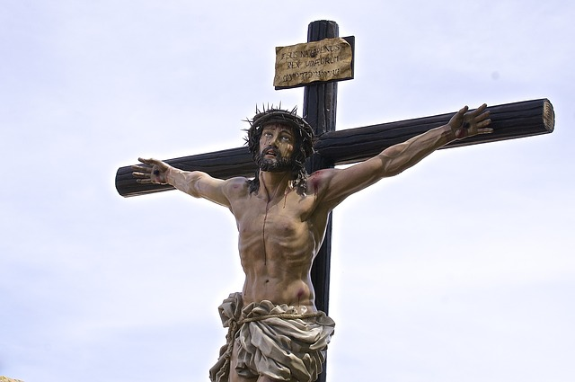
Final Thoughts
Q: Why is God able to forgive our sins?
A: The suffering and death of Christ on the cross is the reason God forgives.
A: In confession we receive God’s promise of the forgiveness of sins on account of Christ.

Slide 15
Questions?
Notes:
Prayer: Almighty and everlasting God, through Your Son You have promised us forgiveness of sins and everlasting life. Govern our hearts by Your Holy Spirit that in our daily need, and especially in all time of temptation, we may seek Your help and, by faith in Your Word, obtain all that You have promised; through Jesus Christ, our Lord. Amen.

