Slide 1
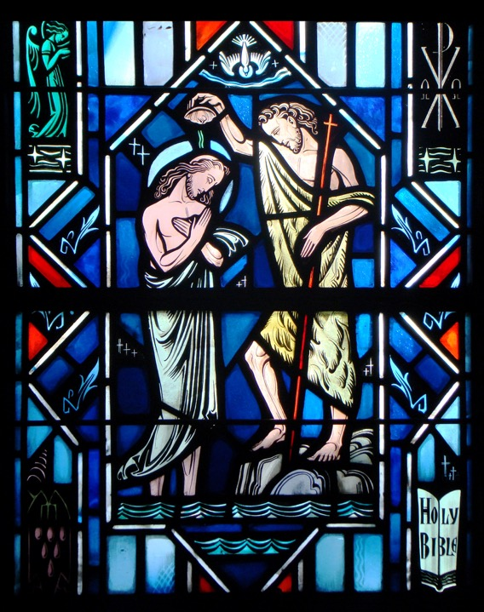
Holy Baptism
Part Three

Slide 2
Review
- Assignment -

Slide 3
2 Kings 5:1-14
Read 2 Kings 5:1-14
Q: What was Naaman’s vocation?
A: Commander of Syrian army!
Q: What was his health problem?
A: Leprosy!
Q: What is leprosy?
A: disfiguring and often deadly skin disease.

Slide 4
2 Kings 5:1-14
Q: Who told Naaman of a cure for his disease?
A :A captive girl from the land of Israel!
Consider the kind action of this little girl. She was stolen from her home. Forced to serve in a foreign land. Yet, looking out for the good of the one who was now her master.

Slide 5
2 Kings 5:1-14
Q: Naaman took a whole lot of something along with him - what was it?
A: Money - wealth
Q: Why?
A: He wanted to buy help and healing for his disease from an enemy king. Yet, at the end, there are some things money can’t buy. God is the ultimate healing of the leprosy of our sin.

Slide 6
2 Kings 5:1-14
Q: What did the King of Israel do when he received the letter from the King of Syria?
A: The King of Israel thought the King of Syria was trying to start a quarrel with him and his country. Therefore, He tore his clothes (v. 7). This is a sign of disgust, grief, or anger.
Q: What question did he ask?
A: Am I God? (v. 7)
Q: Who does all healing come from?
A: God

Slide 7
2 Kings 5:1-14
Q: Did Elisha go out to see Naaman?
A: No, he sent a messenger to tell him to dip in the Jordan River seven times.
Q: What was Naaman’s first reaction?
A: He was furious!

Slide 8
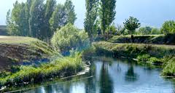
2 Kings 5:1-14
Q: To what did Naaman compare the Jordan River?
A: Rivers in his homeland - Abana and Pharpar.
A picture of the Abana River – now the Barada River – a chief river in Syria still today.

Slide 9
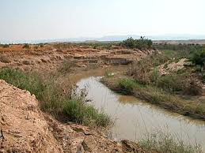
2 Kings 5:1-14
The Jordan River

Slide 10
2 Kings 5:1-14
Which river would you rather go swimming in?
The Jordan River was considered inferior. The reputation of Israel was that of being poor and conquered.
We judge by our sight – our experience – our feelings. We tend to judge by our senses and not by the Word of God.

Slide 11
2 Kings 5:1-14
In order to receive the prophet’s word, Naaman had to be converted.
Naaman rejected the Word of the Lord, because he trusted in himself.
The benefit of the Lord’s cleansing salvation in the waters of the Jordan River was not received by Naaman, because he refused to repent of his sin and believe in the promise of the word.

Slide 12
2 Kings 5:1-14
Q: What finally helped persuade Naaman to wash and be clean?
A: His servants (v. 13)
Q: What did they say the prophet had spoken?
A: A great word!
The servants admonished him by directing him away from himself to the free offer of the cleansing in the word of the prophet. As long as Naaman held on to his own pride, the couldn’t receive the Lord’s cleansing. It was the word of the Lord, from the prophet, through his messengers and Naaman’s servants, which finally brought Naaman to faith.

Slide 13
2 Kings 5:1-14
This story teaches us that the power of the baptismal water lies in the Word and promise of Christ. He’s the saving content of the water and Baptism, and by His Word the Spirit of God delivers those benefits to us in Baptism.
This story also teaches us that it is the Word of God alone which breaks the hardness of the sinful heart, so that it believes in the promise of Baptism and receives the salvation and cleansing which Baptism contains.

Slide 14
Small Catechism
How can water do such great things?
Certainly not just water, but the Word of God in and with the water does these things, along with the faith which trusts this word of God in the water. For without God’s word the water is plain water and no Baptism. But with the word of God it is a Baptism, that is, a life-giving water, rich in grace, and a washing of the new birth in the Holy Spirit, as St. Paul says in Titus, chapter three:
“He saved us through the washing of rebirth and renewal by the Holy Spirit, whom He poured out on us generously through Jesus Christ our Savior, so that, having been justified by His grace, we might become heirs having the hope of eternal life. This is a trustworthy saying.” (Titus 3:5-8)

Slide 15
Small Catechism
How can water do such great things?
Q: What are the great things mentioned here?
A: They are the:
Forgive sins
Rescues from death and the devil
Gives eternal salvation

Slide 16
Small Catechism
Certainly not just water, but the Word of God in and with the water does these things, along with the faith which trusts this word of God in the water. For without God’s word the water is plain water and no Baptism. But with the word of God it is a Baptism, that is, a life-giving water, rich in grace, and a washing of the new birth in the Holy Spirit, as St. Paul says in Titus, chapter three…
The Word of God has power.
Faith receives what the Word gives.

Slide 17
Small Catechism
“He saved us through the washing of rebirth and renewal by the Holy Spirit, whom He poured out on us generously through Jesus Christ our Savior, so that, having been justified by His grace, we might become heirs having the hope of eternal life. This is a trustworthy saying” (Titus 3:5-8).
Father – Son – Holy Spirit

Slide 18
Small Catechism
“He saved us through the washing of rebirth and renewal by the Holy Spirit, whom He poured out on us generously through Jesus Christ our Savior, so that, having been justified by His grace, we might become heirs having the hope of eternal life. This is a trustworthy saying” (Titus 3:5-8).
Father – Son – Holy Spirit
Jesus’ death and resurrection are the source of the gift of the Spirit and our justification.

Slide 19
Small Catechism
“He saved us through the washing of rebirth and renewal by the Holy Spirit, whom He poured out on us generously through Jesus Christ our Savior, so that, having been justified by His grace, we might become heirs having the hope of eternal life. This is a trustworthy saying” (Titus 3:5-8).
Father – Son – Holy Spirit

Slide 20
Small Catechism
“He saved us through the washing of rebirth and renewal by the Holy Spirit, whom He poured out on us generously through Jesus Christ our Savior, so that, having been justified by His grace, we might become heirs having the hope of eternal life. This is a trustworthy saying” (Titus 3:5-8).
Through Baptism, you’re heirs with Christ!
“For in Christ Jesus you are all sons of God, through faith. For as many of you as were baptized into Christ have put on Christ. There is neither Jew nor Greek, there is neither slave nor free, there is no male and female, for you are all one in Christ Jesus. And if you are Christ's, then you are Abraham's offspring, heirs according to promise” (Gal. 3:26-29).

Slide 21
Large Catechism
“Baptism is quite another thing than all other water; not on account of the natural quality but because something more noble is here added; for God Himself stakes His honor, His power and might on it. Therefore it is not only natural water, but a divine, heavenly, holy, and blessed water, and in whatever other terms we can praise it,-all on account of the Word, which is a heavenly, holy Word, that no one can sufficiently extol, for it has, and is able to do, all that God is and can do” (LC IV 17).

Slide 22
Large Catechism
“… faith must have something which it believes, that is, of which it takes hold, and upon which it stands and rests. Thus faith clings to the water, and believes that it is Baptism, in which there is pure salvation and life; not through the water (as we have sufficiently stated), but through the fact that it is embodied in the Word and institution of God, and the name of God inheres in it. Now, if I believe this, what else is it than believing in God as in Him who has given and planted His Word into this ordinance, and proposes to us this external thing wherein we may apprehend such a treasure? ” (LC IV 29).

Slide 23
Baptism in the Liturgy

Slide 24
Questions?

