Slide 1
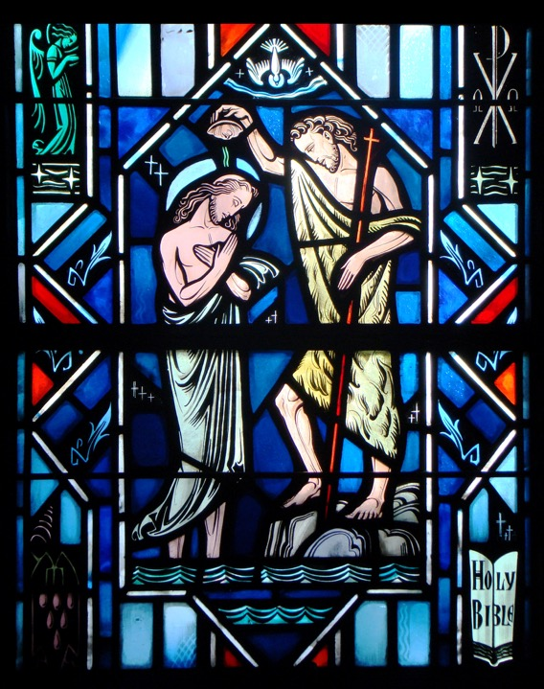
Holy Baptism
Part Two

Slide 2
Review
Assignment

Slide 3
Holy Baptism
What benefits does Baptism give?

Slide 4
Benefits of Baptism
Up to this point we’ve talked about ”What is Baptism?”
We said it consists of two things: water and God’s Word (Mandating Word).
But why does God institute Baptism?
For what benefit, fruit, and purpose does it have?

Slide 5
Genesis 6:9-18
Read Genesis 6:9-18
Q: How is Noah described?
A: He was a righteous man, blameless in his generation. He walked with God (v.9). This wasn’t because of his works but because of faith.
Q: How are the other people on the earth described?
A: Corrupt and filled with violence (v. 11-12).
Q: Because of this corruption, what was God going to do? A: He was going to destroy those on the earth through a world wide flood (v.13, 17).
Q: Did this include Noah?
A: No, Noah and his family would be saved by an ark that Noah would make (v.14-16, 18)

Slide 6
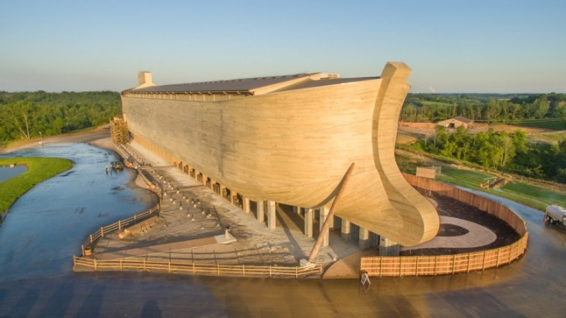
Genesis 6:9-18
Q: Would Noah and his family die as well?
A: No, Noah and his family would be saved. God commanded Noah to build an ark (v.14-16, 18).

Slide 7
Genesis 6:19-7:10
In Gen. 6:17-22 notes that:
Animals of every sort, after their kind.
Brought in two by two, male and female, to have babies and fill the earth after the flood ended.
In Gen. 7:1-10 note that:
Seven pairs of clean animals (ie - sheep) were brought on board for sacrifices.
Dinosaurs would have been on the ark. However, a pair that wasn't fully mature.
God also commanded food to be taken on the ark.

Slide 8
Genesis 7:11-24
In Gen. 7:11-24 notes that:
The waters from below and from above were opened until every mountain was covered.
The surface of the earth was drastically changed.
Every living thing was blotted out.
This would have included even birds. This wasn't a storm any bird could fly through. There was no place to land for 150 days.
There was no place of safety on the entire face of the earth except on the ark.

Slide 9
Genesis 7:11-24
Q: What caused this destruction?
A: God's wrath against sin.
Q: How many places were safe?
A: Only, one - on God's ark. You were either in God's place of safety or you were dead and blotted out of God's book of life.
Q: Who was saved?
A: Noah and his family - eight in all.

Slide 10
Benefits of Baptism
Read 1 Peter 3:18-22
The prime connection that the Holy Spirit makes in the rescue of Noah amid total destruction is God's rescue of you from eternal death in Holy Baptism.
Holy Baptism saves us because Jesus Christ is the content of Holy Baptism. He is the sinless, righteous one. Humanity is sinful, unrighteous.

Slide 11
Benefits of Baptism
In Jesus’ baptism (Matt. 3:13-17), the sin of the world was imputed to Him that He might suffer and die to make atonement for all sin.
The resurrection of Christ from the dead proclaims the forgiveness of sins that He earned through His death on the cross. That forgiveness is at the center of Holy Baptism.
Just as Noah and his family were literally saved from the sinful world through water, so we are saved from our sins through water by the resurrection of Christ from the dead.

Slide 12
Benefits of Baptism
Look up the following Scripture passages to see what great things God does through Baptism:
Acts 2:38
Col. 2:11-12
Rom. 6:3-5
Titus 3:5-7
Acts 22:16
Mark 16:16
Forgives sins
Rescues from death and the devil.
Gives eternal salvation

Slide 13
Small Catechism
What benefits does Baptism give?
It works forgiveness of sins,
rescues from death and the devil,
and gives eternal salvation to all who believe this,
as the words and promises of God declare.
Declared “righteous for Christ’s sake” / Justification.

Slide 14
Small Catechism
Which are these words and promises of God?
Christ our Lord says in the last chapter of Mark: “Whoever believes and is baptized will be saved,
but whoever does not believe will be condemned.” (Mark 16:16).
Christ is the object of faith:
“Whoever believes in Christ…”
Whoever doesn’t believe in Christ…”

Slide 15
Questions?

