Slide 1
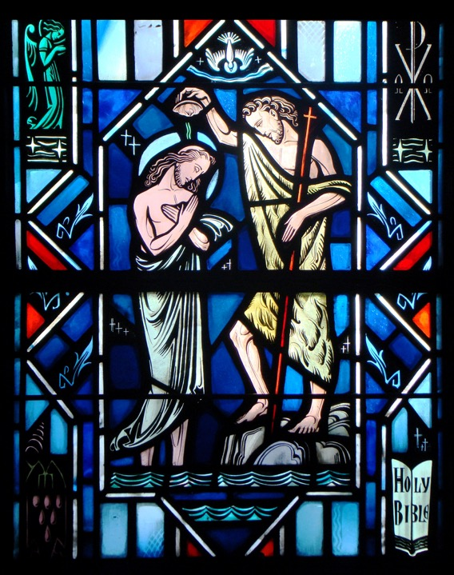
The Means of Grace & Holy Baptism
Part One

Slide 2
Review
- The Lord’s Prayer -
- Assignment -

Slide 3
The Means of Grace

Slide 4
The Means of Grace
Q: How many of you like receiving gifts?
A: We all like receiving gifts.
Often, the gifts we receive are delivered in a box. The box is considered the means (instrument/method) through which the gift is given.
Prior to our discussion on Baptism, we should understand the Means of Grace.

Slide 5
The Means of Grace
Q: What do we confess that Christ has done in the 2nd Article of the Creed?
A: We confess that He has redeemed me, a lost and condemned person, purchased and won me from all sins, from death, and from the power of the devil with His holy precious blood and with His innocent suffering and death.

Slide 6
The Means of Grace
Q: What do we confess that the Holy Spirit does in the 3rd Article of the Creed?
A: The Holy Spirit “calls, gathers, enlightens, and sanctifies the whole Christian church” through the proclamation of Gospel – that is, the forgiveness of sins in Christ.
The Gospel is given to us through God’s written and spoken Word.
The Gospel is also joined to earthly elements in sacred acts that Christ has given (ie – Baptism and the Lord’s Supper).

Slide 7
The Means of Grace
Baptism, Holy Absolution, and the Lord’s Supper
are considered “Means of Grace.”
Through earthly elements of water, bread and wine, and the Word (means), the triune God delivers His gifts of forgiveness of sins, life, and salvation (grace).

Slide 8
Holy Baptism
What is Baptism?

Slide 9
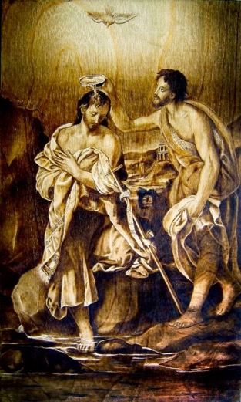
Matthew 3:1-17
Read Matthew 3:1-17
Q: What did John the Baptist preach?
A: Repentance for the forgiveness of sins! He directed the faith of the sinner to Christ, the source of forgiveness and salvation.

Slide 10
Matthew 3:1-17
Q: What is repentance?
A: Repentance (in the broad sense) is two fold:
First, the sorrow over sin that comes through the preaching of the Law.
Second, Faith in the promise of the forgiveness of sins for Christ’s sake. This comes through the preaching of the Gospel.
Q: To whom did John direct the people?
A: Jesus Christ

Slide 11
Matthew 3:1-17
Q: What did the people do who received John’s preaching?
A: They were baptized for the forgiveness of sins in the Jordan River.
John’s baptism worked the forgiveness of sins. He made it clear that the source of the forgiveness was Jesus Christ.
Q: What verse indicates John was shocked when Jesus comes to him for Baptism?
A: Verse 14: “I need to be baptized by you, and do you come to me?”

Slide 12
Matthew 3:1-17
Q: Why would John try to prevent Jesus from being Baptized?
A: Baptism is for the forgiveness of sin. Jesus is the sinless One. He’s the source of our forgiveness.
Yet, Jesus is the source of our forgiveness because Jesus becomes sin for us.
St Paul writes, “God was in Christ reconciling the world to Himself, not imputing their trespasses to them…For He made Him who knew no sin to be sin for us, that we might become the righteousness of God in Him” (2 Cor. 5:19, 21).

Slide 13
Matthew 3:1-17
Christ, the Lamb of God who takes away the sin of the world, is the saving content of Holy Baptism.
In His Baptism, Jesus unites Himself with sinful man. He assumes the responsibility for the sin of the world.
Jesus’ Baptism designates Him our sin-bearer – the very Lamb of God who takes away the sin of the world by offering up His life in death on our behalf.
Jesus fulfills the Law of God, and all righteousness on our behalf, by suffering the punishment and death demanded by the Law.
We are clothed with Him in our Baptism only because He clothed Himself with our sin in His baptism.

Slide 14
Matthew 3:1-17
Q: Why is the Father pleased with Jesus?
A: Because Jesus is obeying the Father’s will to take our sin upon Himself.
Q: Why does the Holy Spirit anoint Jesus?
A: For His work of redeeming us.
Q: What does this tell you about the Holy Trinity’s will for you?
A: The one true God is unmistakably for you - desiring your redemption - not wanting you to perish.

Slide 15
Matthew 3:1-17
Q: Was the Father, Son, and Holy Spirit present at your baptism just as at Jesus’ baptism?
A: Yes! The Father speaks His Word of divine approval upon us for Jesus’ sake. The water of Holy Baptism washes our sin away and gives us Christ’s righteousness in exchange. The Holy Spirit bestows on us the new life of faith.

Slide 16
The Institution of Holy Baptism
What is Baptism?

Slide 17
Matthew 28:16-20
Ready Matthew 28:16-20
Q: When does this event take place?
A: After Christ’s resurrection but before His ascension into heaven.
Q: How many disciples were there? Who was missing?
A: Eleven. Judas wasn’t there.
Q: What were the disciples doubting?
A: While not unbelief, they had a hard time absorbing the fact Christ has rose from the dead.

Slide 18
Matthew 28:16-20
Q: How much authority has been given to Christ?
A: All authority in heaven and earth has been given to Him by God! This authority isn’t limited to just Christ’s divine nature, but includes His human nature as well.
Q: What does Christ do with His authority?
A: Christ commissions His disciples to go and make disciples, not just of a couple people, but of all nations. Not just Jews but also Gentiles. Not just men but also women. Not just adults but also infants. All people! All nations!
Q: How are the disciples to do this?
A: Through baptizing and teaching.

Slide 19
Matthew 28:16-20
Q: What does it mean to baptize?
A: It comes from the Greek word βαπτίζω, which means “to wash with water.” This can be done by immersing, pouring, or sprinkling.
Mark 7:4 says, “And when they came from the marketplace they do not eat unless they wash (baptize). And there are many other traditions that they observe, such as the washing (baptizing) of cups and pots and copper vessels and dining couches.”

Slide 20
Matthew 28:16-20
Q: Why did we start our discussion on baptism with these verses from Matthew 28?
A: These are the words upon which baptism is founded! These words contain God’s mandate and institution. Christ says to us, “Baptize!”
Luther writes, ”…here stand God’s Word and command that have instituted, established, and confirmed baptism. What God institutes and commands cannot be useless. Rather, it is a most precious thing, even though to all appearances it may not be worth a straw.” (LC IV 8-9).

Slide 21
Matthew 28:16-20
Q: Are the disciples to baptize in their own name?
A: No! They are to baptize in the name of the Father and of the Son and of the Holy Spirit.
Luther writes, “To be baptized in God’s name is to be baptized not by human beings but by God himself. Although it is performed by human hands, it is nevertheless truly God’s own act. From this fact everyone can easily conclude that it is of much greater value than the work of any human being or saint. For what human work can possibly be greater than God’s work?” (LC IV 10).
In Baptism, God puts His saving name on us and is truly present to bless us with all His gifts as His children.

Slide 22
Matthew 28:16-20
Simply put, Baptism is the application of water to a person in the name of the Holy Trinity – the Father and the Son and the Holy Spirit. Plain water is truly used in this Sacrament, but it is not plain water alone.
Our Lord Jesus Christ, following His death and resurrection and just before His ascension, gave the church the gift of Holy Baptism. So it is the water of Holy Baptism is used according to Jesus’ command and combined with the name of God and all that name stands for. This God-given reality changes everything about this particular application of water.

Slide 23
Matthew 28:16-20
Simply put, Baptism is the application of water to a person in the name of the Holy Trinity – the Father and the Son and the Holy Spirit. Plain water is truly used in this Sacrament, but it is not plain water alone.
Our Lord Jesus Christ, following His death and resurrection and just before His ascension, gave the church the gift of Holy Baptism. So it is the water of Holy Baptism is used according to Jesus’ command and combined with the name of God and all that name stands for. This God-given reality changes everything about this particular application of water.

Slide 24
Small Catechism
What is Baptism?
Baptism is not just plain water,
but it is the water
included in God’s command
and combined with God’s Word.
Which is that Word of God?
Christ our Lord says in the last chapter of Matthew: “Therefore go and make disciples of all nations, baptizing them
in the name of the Father and of the Son
and of the Holy Spirit.” (Matt. 28:19)

Slide 25
Small Catechism
Question:
At the end of the day, if I were to ask what two things does Baptism consists of, what would you say?
Answer:
Water & God’s Word (His Mandating Word)

Slide 26
Questions?

