Slide 1
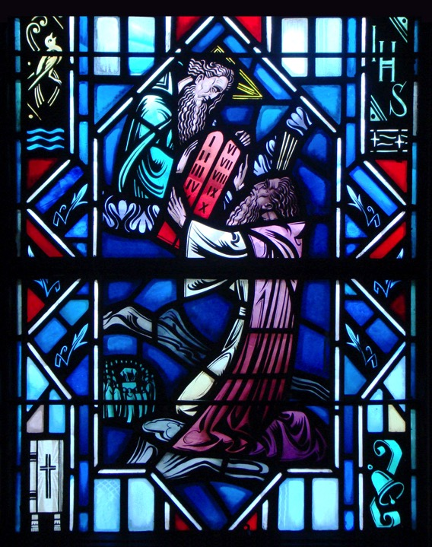
The Ten Commandments
Introduction to the Commandments
and The First Commandment

Slide 2
Review from Last Class

Slide 3
Introduction to the
Ten Commandments

Slide 4
Introduction
Read Exodus 20:1-21
Q: What is the context of this passage?
A: After Israel’s exodus from Egypt and at the bottom of Mt. Sinai.
Q: Why start here with this passage?
A: It’s here where God gives to the Israelites His commandments. God’s commandments are not made up but are taken from Scripture.
Q: What were the Israelites’ reaction to God speaking?
A: Fear! God graciously gave the Israelites a tangible experience of His presence so they would take these commands seriously.

Slide 5
Introduction
Read Romans 2:14-16
Q: What is another way God gives the Law to us?
A: It’s written on our hearts.
Q: Does this mean all people, even unbelievers, have a knowledge of God’s Law?
A: Yes! He gives all people some knowledge of His Law.
Through the conscience, people have an internal ability to make some discernment between right and wrong. However, this is fallen and fallible.

Slide 6
Introduction
We see two ways God’s Law is given to us:
Exodus 20:1-17 – Divine Revelation
Romans 2:14-16 – By Nature
The Ten Commandments:
The Ten Commandments are God’s good and loving will for the lives and well-being of all people within His creation.

Slide 7
Introduction
Matthew 22:36-40
“‘Teacher, which is the great commandment in the Law?’ And he said to him, ‘You shall love the Lord your God with all your heart and with all your soul and with all your mind. This is the great and first commandment. And a second is like it: You shall love your neighbor as yourself. On these two commandments depend all the Law and the Prophets.’”
God’s will for our lives:
Love God (Commandments 1-3)
Love our neighbor (Commandments 4-10)

Slide 8
The First Commandment
The Rich Man and Lazarus (Luke 16:19-31)

Slide 9
Luke 16:19-21
Q: What does it mean that the rich man was clothed in purple and fine linen?
A: Clothed as one respected and honored in the community – a leader - a merchant – perhaps employing many. The rich man represents the “Pharisees” who were earlier described as “lovers of money” (16:14).
Q: What does it mean to feast sumptuously everyday? Do most wealthy people feast every day?
A: No – this is generally reserved for the extraordinary occasion – Sunday gathering – Birthday – Wedding – Family get together – Holidays – Thanksgiving/Christmas/Easter. This rich man was out of control.
Notes:
Read Luke 16:19-31
Go through Questions and Answers

Slide 10
Luke 16:19-21
Q: What was Lazarus’ status in the community?
A: His was the lowest status – a lowly beggar – the dogs licked his sores. He represents the outcasts of Jewish society whom Jesus ministered to.
Q: How did he get to the rich man’s gate?
A: He was laid there by others. He had to rely on others for survival – perhaps crippled or too weak to walk.
Q: Why would people who wanted to help him lay him there?
A: In the hope that the rich man or his guests as they come and go would have pity on him and give him something from the table!
Notes:
Go through Questions and Answers

Slide 11
Luke 16:19-21
Q: Was the dog’s licking his wounds good or bad?
A: Not good. The household dogs would have received the crumbs. Lazarus is so helpless, he is not able to keep the dogs away from his undressed wounds. Additionally, the dogs would have carried germs, and spread diseases.
Notes:
Go through Questions and Answers

Slide 12
Luke 16:22-26
Q: What great enemy of mankind is present in verse 22?
A: Death! It isn’t natural! It’s a curse! This enemy has been destroyed through Christ!
Q: What or where does “Abraham’s side” represent? A: Heaven! (Pictured as a heavenly feast – reclining by another’s side – the Messianic feast)
Q: Where or what does the torment in Hades mean?
A: Hell! The scene now shifts from heaven to hell!
Notes:
Go through Questions and Answers

Slide 13
Luke 16:22-26
Q: Would you describe the great reversal that has taken place for the rich man?
A: Had everything – pampered himself – on earth! Has nothing – separate from God (what the rich man sought all along by putting himself in place of God) – in eternal agony in hell! (Proud on earth – in hell a beggar)
Q: Would you describe the great reversal that has taken place for Lazarus?
A: Nothing on earth – pain and suffering. A beggar on earth – fully blessed in heaven - eternal rest and feasting !
Q: Was the rich man a sinner? Did the rich man fear, love, and trust in God? In what did he trust?
A: In himself, his name and status and wealth. He was proud of and trusted in self.
Notes:
Go through Questions and Answers

Slide 14
Luke 16:22-26
Q: Was the Lazarus a sinner?
A: Yes
Q: Did Lazarus go to heaven because he was poor?
A: No, he went to heaven because His God was the God of Abraham (Abraham is the father of all who believe). In his beggar’s condition and suffering Lazarus trusted God to help him through the Messiah – Christ Jesus (as did Abraham) – whose faith was credited to him as righteousness.
Let’s read Galatians 3:5-14. Are you a son (child) of Abraham?
Notes:
Go through Questions and Answers

Slide 15
Luke 16:27-31
Q: What did the rich man request from hell for his brothers?
A: A miracle that was also an accusation against God for not doing enough and that saw Lazarus as his slave!
Q: Was his concern motivated out of love for God?
A: Their actions would merely be to try to avoid his fate – not out of love for God.
Notes:
Go through Questions and Answers

Slide 16
Luke 16:27-31
Q: What was Abraham’s response?
A: “They have Moses and the prophets…” This means the OT – which was read each week in the synagogue like we read from Scripture each week in the Divine Service. Our place in heaven rests on the Word of God – the Word made flesh who fulfilled the OT. He did rise from the dead and even then many would not believe in Him.
Q: What alone can bring a sinner to repentance and faith in Jesus Christ?
A: The rich man refused to listen to the only thing that could have rescued him: the Word of God.
Notes:
Go through Questions and Answers

Slide 17
Luke 16:27-31
Q: What is an idol?
A: An idol is a false god, something or someone in which our heart trusts and believes or pursues and honors as the greatest good. Some idols are yourself; money; TV stars; sports; entertainment; peers/friends; - the idols of our hearts shift and change. Idolatry is primarily a heart which pursues other things and does not believe that whatever good it receives comes from God.
Q: Who is the one true God?
A: The Father, the Son, and the Holy Spirit. The Holy Trinity. 3 in 1. 1 in 3. Each is God, not a part of God. The God who created you and redeemed you and baptized you. He not a mathematical formula but is living and active and full of love and mercy for you. The Holy Trinity is unmistakably for you.
Notes:
Go through Questions and Answers

Slide 18
Luke 16:27-31
Q: What is repentance?
A: Confess your sins and receive absolution, have faith in the word. Preaching of repentance and the forgiveness of sins tells us what Jesus’ death and resurrection means and calls us to trust in Christ alone for salvation. Repentance is the knowledge of sin and turning towards God’s mercy in Christ Jesus.
Q: To whom do Moses, the Prophets, and all of Scriptures point?
A: Jesus – See Luke 24:44-47
Notes:
Go through Questions and Answers

Slide 19
Ten Commandments in
The Small Catechism
First Chief Part

Slide 20
The First Commandment
You shall have no other gods.
What does this mean?
We should fear, love, and trust in God above all things.
Notes:
1) The First Commandment: Recite together.

Slide 21
The First Commandment
You shall have no other gods.
What does this mean?
We should fear, love, and trust in God above all things.
“Trust Me!”
Notes:
1) The First Commandment: Recite together.

Slide 22
The First Commandment
You shall have no other gods.
What does this mean?
We should fear, love, and trust in God above all things.
Synonyms for faith.
Notes:
1) The First Commandment: Recite together.

Slide 23
The First Commandment
You shall have no other gods.
What does this mean?
We should fear, love, and trust in God above all things.
The Holy Trinity: Father, Son, and Holy Spirit.
Notes:
1) The First Commandment: Recite together.

Slide 24
The First Commandment
Large Catechism states:
“What does it mean to have a god or, what is a god? Answer: A god means that from which we are to expect all good and to which we are to take refuge in all distress, so that to have a God is nothing else than to trust and believe Him from the [whole] heart; as I have often said that the confidence and faith of the heart alone make both God and an idol. If your faith and trust be right, then is your god also true; and, on the other hand, if your trust be false and wrong, then you have not the true God; for these two belong together, faith and God. That now, I say, upon which you set your heart and put your trust is properly your god” (LC I 1-3).

Slide 25
The First Commandment
Large Catechism states:
“Thus it is with all idolatry; for it consists not merely in erecting an image and worshiping it, but rather in the heart, which stands gaping at something else, and seeks help and consolation from creatures, saints, or devils, and neither cares for God, nor looks to Him for so much good as to believe that He is willing to help, neither believes that whatever good it experiences comes from God” (LC I 21).

Slide 26
The First Commandment
Large Catechism states:
“Let every one, then, see to it that he esteem this commandment great and high above all things, and do not regard it as a joke. Ask and examine your heart diligently, and you will find whether it cleaves to God alone or not. If you have a heart that can expect of Him nothing but what is good, especially in want and distress, and that, moreover, renounces and forsakes everything that is not God, then you have the only true God. If, on the contrary, it cleaves to anything else, of which it expects more good and help than of God, and does not take refuge in Him, but in adversity flees from Him, then you have an idol, another god” (LC I 28).

Slide 27
Taught to Confess
How Christians should be taught to confess from the 1st Commandment:
Have I loved, trusted, or feared other things/people more than God?
Have I committed idolatry by seeking comfort, good, and delight from my own efforts rather than from God?
In all things am I self-centered and selfish?
Do I complain about the troubles, people, work, and sufferings God lays on me?

Slide 28
Questions?
Notes:
Prayer: Almighty and everlasting God, through Your Son You have promised us forgiveness of sins and everlasting life. Govern our hearts by Your Holy Spirit that in our daily need, and especially in all time of temptation, we may seek Your help and, by faith in Your Word, obtain all that You have promised; through Jesus Christ, our Lord. Amen.

