Slide 1
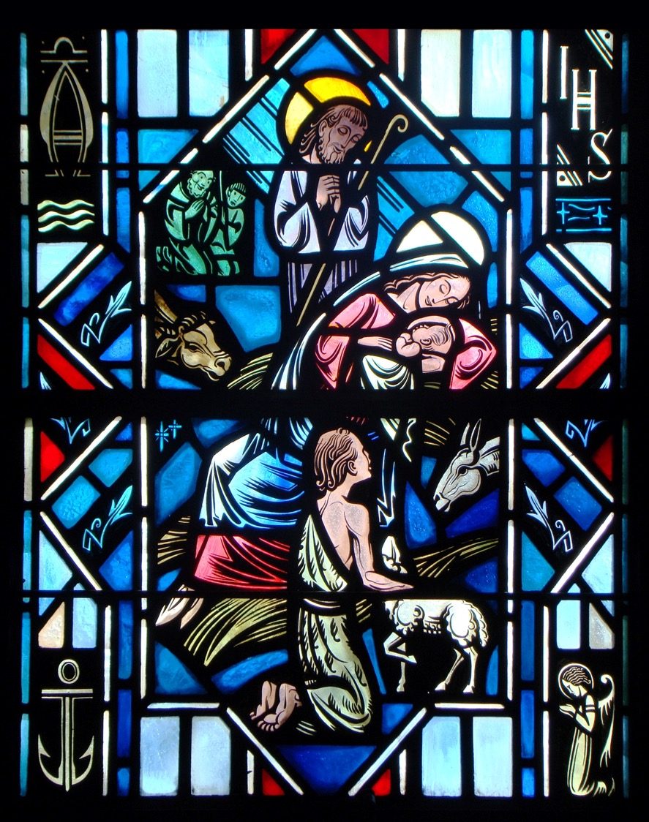
The Apostles’ Creed
Second Article – Part 3

Slide 2
Review
Worksheet

Slide 3
The Apostles’ Creed
And in Jesus Christ, His only Son, our Lord, who was conceived by the Holy Spirit, born of the Virgin Mary, suffered under Pontius Pilate, was crucified, died and was buried. He descended into hell. The third day He rose again from the dead. He ascended into heaven and sits at the right handoff God, the Father Almighty. From thence He will come to judge the living and the dead.

Slide 4
The Apostles’ Creed
And in Jesus Christ, His only Son, our Lord, who was conceived by the Holy Spirit, born of the Virgin Mary, suffered under Pontius Pilate, was crucified, died and was buried. He descended into hell. The third day He rose again from the dead. He ascended into heaven and sits at the right handoff God, the Father Almighty. From thence He will come to judge the living and the dead.
In the Apostles’ Creed, we confess Christ’s:
Two Natures

Slide 5
The Apostles’ Creed
And in Jesus Christ, His only Son, our Lord, who was conceived by the Holy Spirit, born of the Virgin Mary, suffered under Pontius Pilate, was crucified, died and was buried. He descended into hell. The third day He rose again from the dead. He ascended into heaven and sits at the right handoff God, the Father Almighty. From thence He will come to judge the living and the dead.
In the Apostles’ Creed, we confess Christ’s:
Crucifixion and Death and Burial

Slide 6
The Apostles’ Creed
And in Jesus Christ, His only Son, our Lord, who was conceived by the Holy Spirit, born of the Virgin Mary, suffered under Pontius Pilate, was crucified, died and was buried. He descended into hell. The third day He rose again from the dead. He ascended into heaven and sits at the right handoff God, the Father Almighty. From thence He will come to judge the living and the dead.
In the Apostles’ Creed, we confess Christ’s:
Resurrection

Slide 7
The Apostles’ Creed
And in Jesus Christ, His only Son, our Lord, who was conceived by the Holy Spirit, born of the Virgin Mary, suffered under Pontius Pilate, was crucified, died and was buried. He descended into hell. The third day He rose again from the dead. He ascended into heaven and sits at the right handoff God, the Father Almighty. From thence He will come to judge the living and the dead.
In the Apostles’ Creed, we confess Christ’s:
Ascension

Slide 8
The Apostles’ Creed
And in Jesus Christ, His only Son, our Lord, who was conceived by the Holy Spirit, born of the Virgin Mary, suffered under Pontius Pilate, was crucified, died and was buried. He descended into hell. The third day He rose again from the dead. He ascended into heaven and sits at the right handoff God, the Father Almighty. From thence He will come to judge the living and the dead.
In the Apostles’ Creed, we confess Christ’s:
Final Judgment

Slide 9
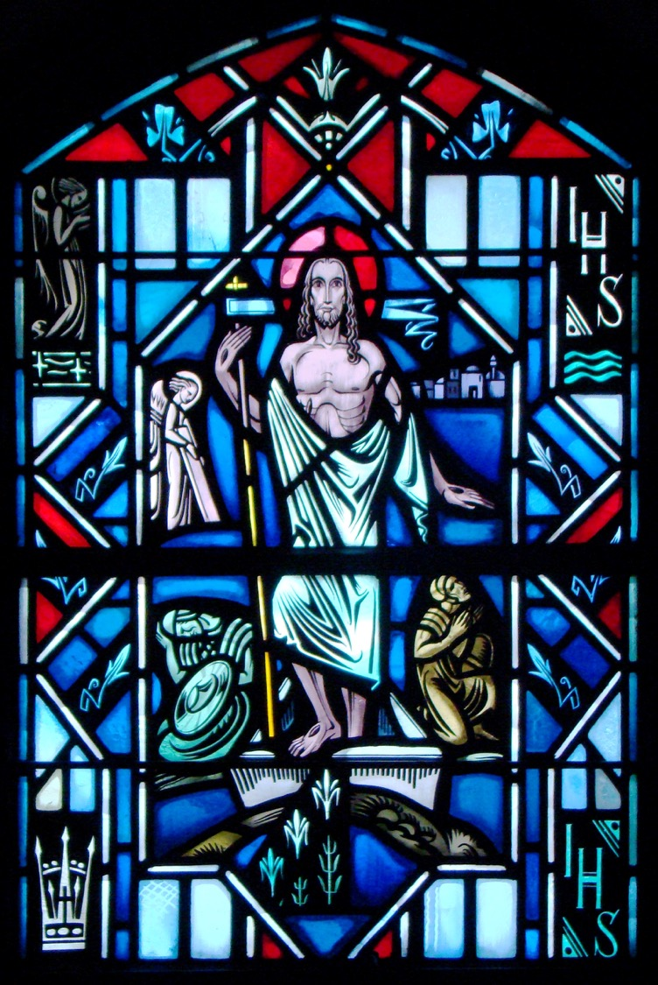
The Apostles’ Creed
The Resurrection of our Lord

Slide 10
The Resurrection of Christ
What happens if Jesus didn’t rise from the dead? Does it matter? If He didn’t, would you still want to be a Christian?
Read 1 Corinthians 15:12-18
If Christ isn’t raised from the dead…
Our preaching is in vain (v.14).
Your faith is in vain (v.14).
We are misrepresenting God (v.15).
The dead aren’t raised (v.16).
Your still in your sins (v.17).
Those who die will perish (v. 18).
If Christ isn’t raised from the dead, Paul is right, “…We are of all people most to be pitied” (v. 19).
“But in fact Christ has been raised from the dead, the firstfruits of those who have fallen asleep” (v.20).

Slide 11
Mark 16:1-8
Read Mark 16:1-8
Q: What day of the week did Mary Magdalen and Mary and Salome go to the tomb?
A: The first day of the week (v. 2), which would have been a Sunday.
Q: Would they be able to move the stone in front of the tomb? What does this indicate?
A: No. It revealed the stone was extremely large and heavy, requiring several men to move it.
Q: What did the women find when they got to the tomb?
A: The stone had been rolled back (v.4) and a young man sitting on the right side (v.5). This young man was an angel. Angels typically appear in the form of young, adult males.

Slide 12
Mark 16:1-8
Q: What was the angels announcement to the women?
A: He announces that the Lord who was crucified is risen from the dead (v.6).
The angel calls Him “Jesus of Nazareth” because our Lord is no disembodied spirit. He is truly the Man Jesus in the flesh. Since He is risen from the dead bodily, He is none other than “the Christ, the Son of the living God” (Matt 16:16).

Slide 13
Mark 16:1-8
Jesus Christ had to rise from the dead because His death paid the price for sin demanded by the Law.
He did not rise from the dead simply because He was too powerful to remain in the grave.
Rather, Jesus rose from the dead because His death took away the sins of the world. Jesus actually became the sinner for sinful man, so that in Him sinful man might be justified and reconciled to God.
Romans 4:24-25 – “It will be counted to us who believe in him who raised from the dead Jesus our Lord, who was delivered up for our trespasses and raised for our justification.”

Slide 14
Mark 16:1-8
Q: To whom were the women told to inform that Jesus had rose from the dead?
A: The disciples and Peter (v.7).
Q: Why did the angel specify Peter?
A: Because he had fallen into sin when he denied his Lord (Mark 14:66-72).

Slide 15
Mark 16:1-8
The angel’s message includes more than a report that Jesus has risen from the dead. It carries with it the forgiveness of sins.
To preach the resurrection of Jesus is to apply the forgiveness of sins in His name to sinners. In other words Jesus, who died for sin in the flesh and rose from the dead, is the embodiment of forgiveness, life, and salvation. He is the sinner’s righteousness before God.
This is why the angel is careful to include Peter in the list of the eleven disciples whom the women are to tell. The word of resurrection brought to him by the women announced his forgiveness and restoration.

Slide 16
Mark 16:1-8
Q: What were the angels final words to the women? Why are these words important?
A: “There you will see him, just as he told you” (v.7).
The angel is careful to point out that the word the women are to tell the disciples is anchored in what the Lord Jesus had already taught His disciples. All of this – Christ’s crucifixion, death, and resurrection, happened “according to the Scriptures” and just “as He said.”

Slide 17
The Resurrection of Christ
Jesus’ resurrection is important and also comforting because it reveals:
Jesus rose on the third day and appeared bodily to His disciples.
Acts 10:40-41 “God raised Him on the third day and made Him to appear…who ate and drank with Him after He rose from the dead.”
He is the Son of God
Romans 1:4 “He was declared to be the Son of God in power according to the Spirit of holiness by His resurrection from the dead, Jesus Christ our Lord.”
His teachings is true
John 18:37 Jesus answered, … “For this purpose I was born and for this purpose I have come into the world to bear witness to the truth.”

Slide 18
The Resurrection of Christ
Jesus’ resurrection is important and also comforting because it reveals:
The Father has accepted Christ’s sacrifice, reconciling us to the Father and delivering forgiveness of sins.
Romans 5:10 For if while we were enemies we were reconciled to God by the death of His Son, much more, now that we are reconciled, shall we be saved by His life.
All who believe in Christ will rise bodily to eternal life.
1 Cor. 15:22-23 For as in Adam all die, so also in Christ shall all be made alive. But each in his own order: Christ the firstfruits, then at His coming those who belong to Christ.

Slide 19
The Apostles’ Creed
The Ascension of our Lord

Slide 20
The Ascension of Christ
Read Acts 1:9-11
This passage speaks to Christ’s ascension. This is 40 days after His resurrection. Christ, in the presence of His disciples, ascends bodily to be seated at the right hand of God the Father Almighty.
Q: What does it mean that Christ sits at the right hand of God the Father Almighty?
A: With this expression Scripture teaches that Christ, as true man, is not only present everywhere, but also now fully exercises His divine power over the whole universe(See Eph. 1:20-23).

Slide 21
The Ascension of Christ
What comfort do we get from Christ’s ascension to the right hand of God?
We know that the exalted God-man, Christ:
As our Prophet sends people to proclaim the saving Gospel by the power of the Holy Spirit.
Luke 10:16 The one who hears you hears me.
As our Priest pleads and prays for us before the Father
Rom. 8:34 Christ is the one…who is at the right hand of God, who indeed is interceding for us.
As our King rule and protects His church and governs over all the world especially for the benefit of His church.
Ps. 110:1 The Lord says to my Lord: “Sit at My right hand, until I make Your enemies Your footstool.”

Slide 22
The Ascension of Christ
What comfort do we get from Christ’s ascension to the right hand of God?
Our risen and ascended Lord, Jesus Christ, still lives and comes among us specifically in the Divine Service. He’s present with His gifts to feed His church in His Word and at His Sacraments.
In worship the risen and ascended Lord is present to serve us with His life-giving and life-sustaining gifts of forgiveness.

Slide 23
The Apostles’ Creed
The Second Coming and Judgment Day

Slide 24
Christ’s Second Coming
Read Acts 1:11
This passage not only reveals the ascension of Christ but also speaks to His second coming. At that appointed time, He will return visibly and with great glory.

Slide 25
Christ’s Second Coming
What else does Scripture teach about Christ’s second coming?
Christ will return to judge the world, not to set up an earthly government.
Matt. 25:31-32 When the Son of Man comes in His glory, and all the angels with Him, then He will sit on His glorious throne. Before Him will be gathered all the nations, and He will separate people one from another as a shepherd separates the sheep from the goats.
Christ will return on a specific day known by God alone.
Mark 13:32 But concerning that day or that hour, no one knows, not even the angels in heaven, nor the Son, but only the Father.

Slide 26
Christ’s Second Coming
What else does Scripture teach about Christ’s second coming?
Before Christ returns, there will be increasing turmoil and distress for the church and the world.
Matt. 24:7 Nation will rise against nation, and kingdom against kingdom, ad there will be famines and earthquakes in various places.
The return of Christ is a source of hope and joy for the Christian.
Luke 21:28 When these things begin to take place, straighten up and raise your heads, because your redemption is drawing near.

Slide 27
The Small Catechism
What does this mean? I believe that Jesus Christ, true God, begotten of the Father from eternity, and also true man, born of the Virgin Mary, is my Lord,
Who has redeemed me, a lost and condemned person, purchased and won me from all sins, from death, and from power of the devil; not with gold or silver, but with His holy, precious blood and with His innocent suffering and death,
that I may be His own and live under Him in His kingdom and serve Him in everlasting righteousness, innocence, and blessedness, just as He is risen from the dead, lives and reigns to all eternity.
This is most certainly true.

Slide 28
The Small Catechism
…that I may be His own and live under Him in His kingdom and serve Him in everlasting righteousness, innocence, and blessedness, just as He is risen from the dead, lives and reigns to all eternity. This is most certainly true.
Why did Christ redeem me?
Christ redeemed us so that we may be His own and live under Him in His kingdom and serve Him…

Slide 29
The Small Catechism
…that I may be His own and live under Him in His kingdom and serve Him in everlasting righteousness, innocence, and blessedness, just as He is risen from the dead, lives and reigns to all eternity. This is most certainly true.
What is this righteousness?
The righteousness that is Christ, He bestows on us. This righteousness, innocence, and blessedness is a gift. You have been declared righteous through the death and resurrection of Jesus Christ.

Slide 30
The Small Catechism
…that I may be His own and live under Him in His kingdom and serve Him in everlasting righteousness, innocence, and blessedness, just as He is risen from the dead, lives and reigns to all eternity. This is most certainly true.
How can all those happen?
Christ’s resurrection proclaims His death as the source of salvation.

Slide 31
Questions?

