Slide 1
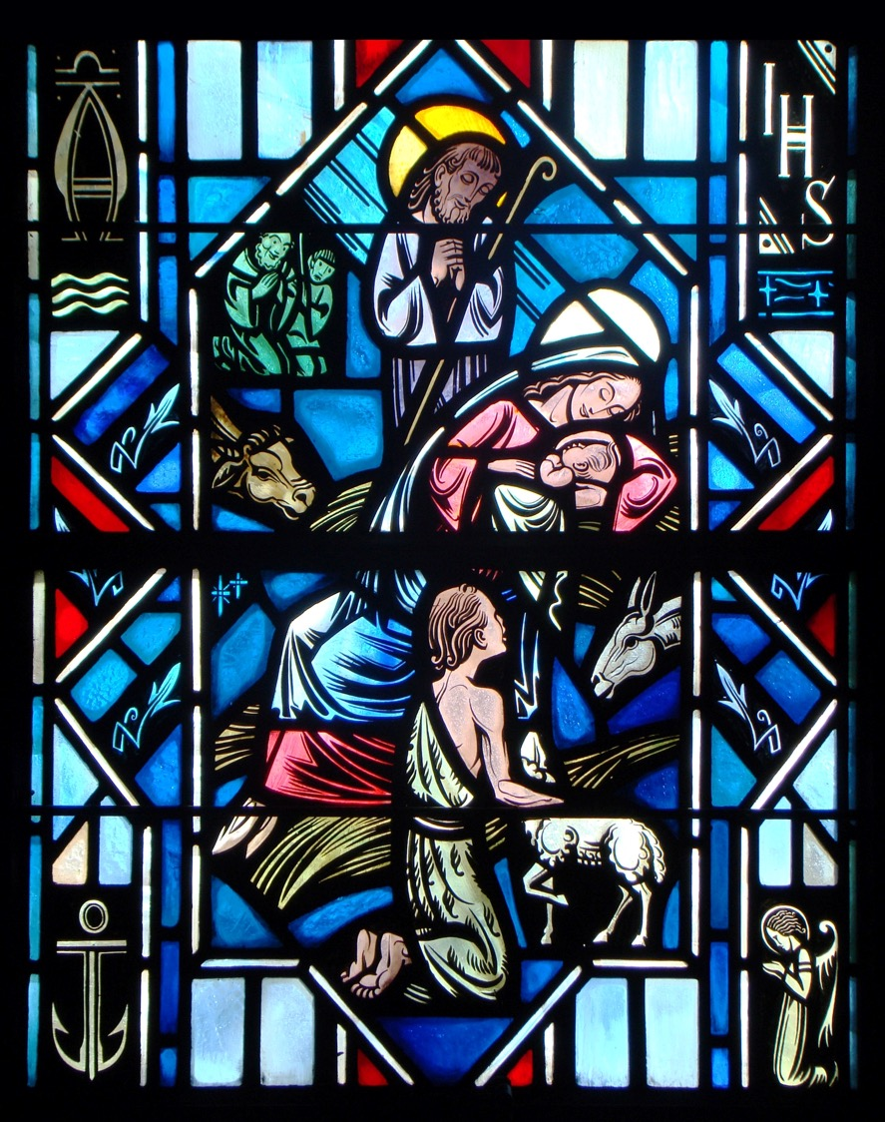
The Apostles’ Creed
Second Article – Part 2

Slide 2
Review
Worksheet

Slide 3
The Apostles’ Creed
And in Jesus Christ, His only Son, our Lord, who was conceived by the Holy Spirit, born of the Virgin Mary, suffered under Pontius Pilate, was crucified, died and was buried. He descended into hell. The third day He rose again from the dead. He ascended into heaven and sits at the right handoff God, the Father Almighty. From thence He will come to judge the living and the dead.
In the Apostles’ Creed, we confess Christ’s:
Two Natures
Crucifixion and Death and Burial
Resurrection
Ascension
Final Judgment

Slide 4
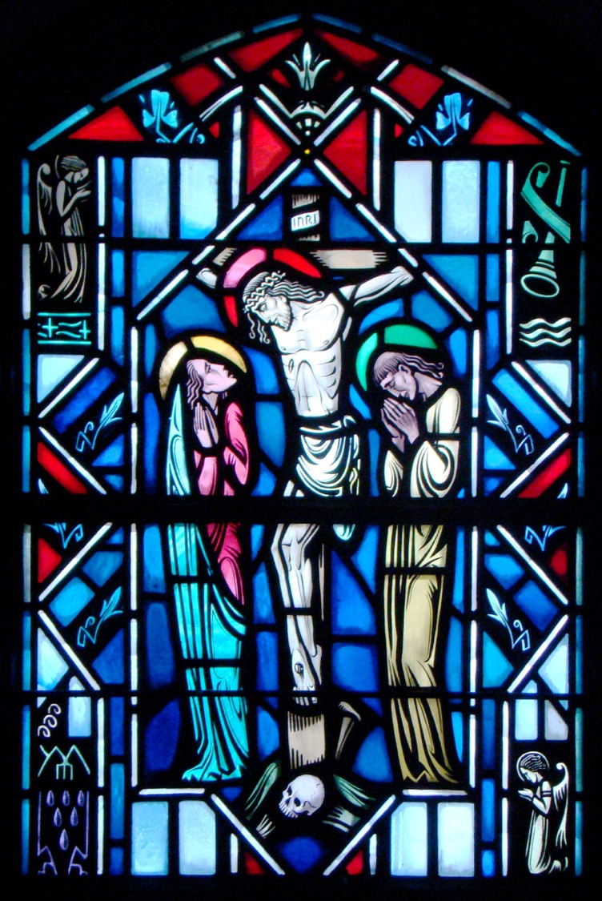
The Apostles’ Creed
The Crucifixion of Our Lord

Slide 5
The Crucifixion
This evening we will briefly review the crucifixion of Jesus Christ. While we’ve heard it often before – listen carefully again and each time you hear it read or proclaimed.
This is the center of human history! This is our life in a dying world! This is the center of God’s love for us sinners! This is the miracle of all the centuries – God in human flesh – dying – even facing damnation for his creatures who have rebelled against Him! This is love beyond telling – and yet we must tell it again and again.

Slide 6
John 18:28-37
Read John 18:28-37
The religious leaders hand Christ over to Pontus Pilate, the Roman Governor.
They believed Jesus was guilty of blasphemy.
However, since they knew Pilate wouldn’t act on that charge, they tried to convince Pilate that Jesus was a political criminal.
Pilate’s authority to judge and condemn criminals was ultimately given to him by God.
Pilate makes his judgment sinfully and based upon expedience.

Slide 7
John 18:28-37
Q: What is Pilate’s first question to Jesus?
A: “Are you the King of the Jews?” (v.34). This question centered on whether Jesus was a king.
Q: How did Jesus respond?
A: “Do you say this of your own accord, or did others say it to you about me?” (v.34). He goes onto say, “My kingdom is not of this world” (v.36).
Jesus was rejecting any worldly political aspirations or rebellious intent. He came to bear witness to the truth – He was speaking of Himself as the way, the truth, and the life. The truth is God’s grace for us sinners in Christ Jesus our Lord.

Slide 8
John 18:38-19:5
Read John 18:38-19:5
Q: How did Pilate respond to Jesus’ comment on truth?
A: ”What is truth?” (v.38).
Pilate’s question is the question of skeptics and the wise and the cultured. Mankind will only grasp at the truth in futile efforts apart from Christ who is truth.

Slide 9
John 18:38-19:5
Q: What is Pilate’s initial verdict of Jesus?
A: ”I find no guilt in him” (v.38).
This should have ended it. However, Pilate makes a foolish concession giving them the choice between releasing an innocent man and a dangerous murderer. To Pilate’s surprise the crowd wants the murderer released.
Pilate proceeds to scourge the man he just declared innocent. Even when He brought the bloodied Jesus back he repeats, “I find no guilt in Him” (v.6).

Slide 10
John 18:38-19:5
Pilate’s statement, “Behold the Man” (v.5), has deep and rich meaning for us children of men.
Jesus is true man – born of the Virgin Mary.
Jesus nursed and grew and hungered and was tempted like us in every way.
Yet, He is also THE MAN in a perfect way. Where the first Adam sinned, and as a result so do we, Christ didn’t. Where we fail, He conquered. The Son of God in human flesh has won the victory – “Behold the Man!”

Slide 11
John 19:6-16
Read John 19:6-16
In his office as governor – Pilate did possess the authority of capital punishment (v.10). Finally, Pilate caved into human pressure and handed over the man he knew to be innocent. It was the cruelest – most shameful death known to the Romans.

Slide 12
John 19:17-30
Read John 19:17-30
Q: What did the inscription say that was placed above Jesus?
A: “Jesus of Nazareth, the King of the Jews.”
It was written in Aramaic (the local language), Latin (Official Language), and Greek (Common language of business in Rome). Everyone would know the crime of the crucified one.
This is how Christ’s kingdom comes – through His sacrificial death for the sins of the world. This was no accident. It is the will of God promised in Eden, a promise finally fulfilled.

Slide 13
John 19:17-30
IT IS FINISHED! (v.30)
This isn’t a cry of defeat but of victory. Everything that God commissioned Jesus to do is accomplished and complete.
All that our sins deserve has been satisfied – including eternal punishment – the suffering of the damned in hell.
As Jesus bows His head in bloody, naked death – He hands over the Spirit who had anointed Him at His baptism.
We have peace by the blood of the cross.
IT IS FINISHED!

Slide 14
The Small Catechism
What does this mean? I believe that Jesus Christ, true God, begotten of the Father from eternity, and also true man, born of the Virgin Mary, is my Lord,
Who has redeemed me, a lost and condemned person, purchased and won me from all sins, from death, and from power of the devil; not with gold or silver, but with His holy, precious blood and with His innocent suffering and death,
that I may be His own and live under Him in His kingdom and serve Him in everlasting righteousness, innocence, and blessedness, just as He is risen from the dead, lives and reigns to all eternity.
This is most certainly true.

Slide 15
The Small Catechism
…Who has redeemed me, a lost and condemned person, purchased and won me from all sins, from death, and from power of the devil; not with gold or silver, but with His holy, precious blood and with His innocent suffering and death…
What are we saying when we confess that Jesus has redeemed us?
Christ has purchased us.
He made a payment for our releases from powers we can’t overcome.

Slide 16
The Small Catechism
…Who has redeemed me, a lost and condemned person, purchased and won me from all sins, from death, and from power of the devil; not with gold or silver, but with His holy, precious blood and with His innocent suffering and death…
Why did we need to be redeemed? What was our situation?
The entire human race lived under they tyranny of sin, death, and the devil.
The entire human race stood under the judgment of God.
We inherited Adam and Eve’s desire to sin and the resulting punishment.

Slide 17
The Small Catechism
…Who has redeemed me, a lost and condemned person, purchased and won me from all sins, from death, and from power of the devil; not with gold or silver, but with His holy, precious blood and with His innocent suffering and death…
How did Jesus redeem me from sin?
By His death on the cross, He paid the entire penalty of my sin and guilt.
By His death on the cross, He fully endured and appeased the wrath of God toward all people.
And thereby reconciling us to God.

Slide 18
The Small Catechism
…Who has redeemed me, a lost and condemned person, purchased and won me from all sins, from death, and from power of the devil; not with gold or silver, but with His holy, precious blood and with His innocent suffering and death…
How did Jesus redeem me from death?
He put death to death by His own death and resurrection.

Slide 19
The Small Catechism
…Who has redeemed me, a lost and condemned person, purchased and won me from all sins, from death, and from power of the devil; not with gold or silver, but with His holy, precious blood and with His innocent suffering and death…
How did Jesus redeem me from the power of the devil?
Christ has completely conquered the devil.
He can no longer accuse us of our sins, and we can resist his temptations.

Slide 20
The Small Catechism
…Who has redeemed me, a lost and condemned person, purchased and won me from all sins, from death, and from power of the devil; not with gold or silver, but with His holy, precious blood and with His innocent suffering and death…
How did Jesus redeem you?
His blood on the cross purchased you from sin, death, and the devil.
He became your substitute. He took your place under God’s judgment against sin. He paid the penalty of your guilt.
Not only did Christ redeem you but all people.

Slide 21
The Divine Liturgy
The Agnus Dei (LSB 198)
These words were first spoken by John the Baptist in the public announcement of Jesus’ ministry.
Summarizes what our Lord came to do.
Christ’s death for our sins as the Lamb of God is the only reason for and source of God’s mercy for all people.
These words fixes our eyes upon Jesus as the Savior who bears in His body our sin.

Slide 22
Questions?

