Slide 1
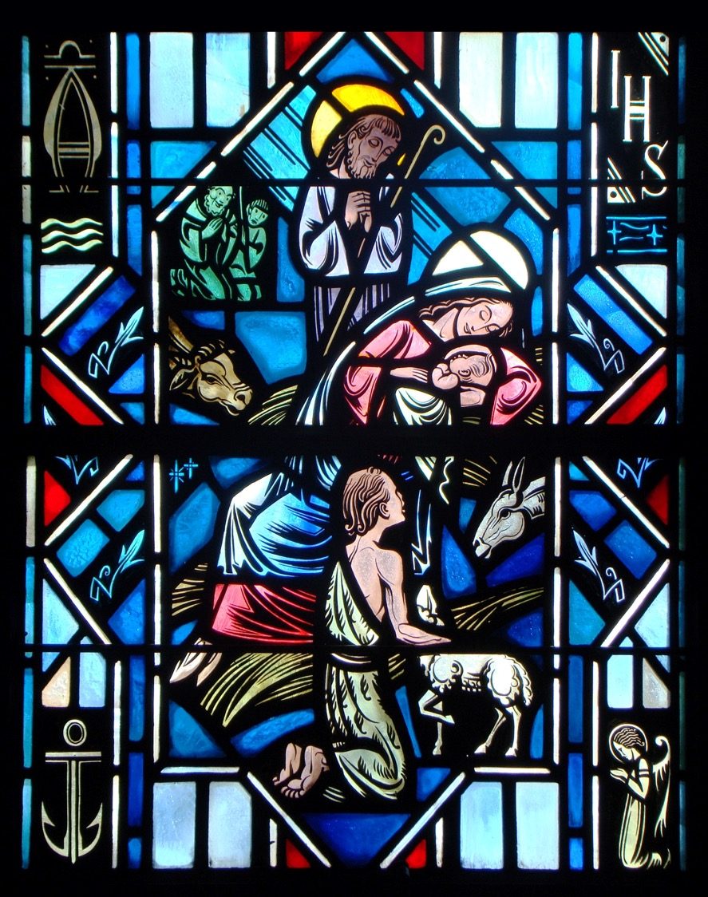
The Apostles’ Creed
Second Article – Part 1

Slide 2
Review
Worksheet

Slide 3
2nd Article of the Creed
Two thousand years after He lived, Jesus is one of the most famous people in the world. People around the globe recognize His name. Even religions outside of Christianity see Jesus as an important person.
Jesus once asked His disciples the question, “Who do people say that I am?” (Mark 8:27).
Question:
What have you heard other people say about Jesus?
As we go through the 2nd Article of the Creed, we’re going to see what Scripture says about Jesus.

Slide 4
Luke 1:26-30
Read Luke 1:26-30
Q: What do we know about Mary?
A: Mary was:
Betrothed to a man name Joseph (She was engaged).
a virgin woman (She didn’t have sexual relations).
Q: What do the angle’s greeting, “O favored one,” indicate?
A: She was chosen by God, by grace alone, to be the mother of the eternal Son.

Slide 5
Luke 1:26-30
Since the time of the promise to Adam and Eve in Genesis 3:15, the faithful have been looking for the “Seed of the woman” who would crush the devil’s hold on man and take away sin and death. Mary was a woman, she was of the proper lineage, she lived at the right time and place, she was of the house of David. Yet, these were all gifts of God of which she could not boast.
Mary wasn’t perfect for even she recognizes her need for a Savior (See Luke 1:47). God’s choice of Mary, like His call to very Christian, was a choice of mercy and love without any merit or contribution on her part. God had come to save man as He had promised. He had come to save Mary from her sin too. This is why she need not fear!

Slide 6
Luke 1:31-35
As sin entered the world through the ears of a woman Eve, “Did God really say?” so the Savior from sin enters the world through the ears and the womb of the woman Mary, “Let it be according to your word.”
As at creation, what God says (i.e. let there be…), He did. So here (You will conceive…), He did.
For a few months, the location of God’s presence on earth shifts from the temple to the womb of the Virgin Mary. The God who is every where was there in Mary’s womb for us – that is to redeem us from sin and death.

Slide 7
Luke 1:36-38
Read Luke 1:36-38
“Nothing will be impossible with God” (Luke 1:37).
Please understand the context for these words. This is one of the most misunderstood and abused promises of the Bible. What God is saying is that “nothing will be impossible in His gracious action to save us from sin and death and hell.” Not even God becoming Man! Creation is impossible for man to accomplish, but not for God. Redemption is impossible for man to accomplish, but not for God.

Slide 8
2nd Article of the Creed
Q: What do you think we started with the story of Jesus’ birth?
A: As the result of the incarnation, the Son of God, the Creator of the universe has taken on human flesh and blood. Scripture reveals to us that the person of Jesus Christ is both true God and true man.
Why does Jesus Christ need to be both true God and true man?

Slide 9
Activity
Split into four groups.
Groups 1 and 3 answer the question, “Why is it necessary for Jesus to be true God?”
John 14:9
1 Peter 1:18-19
Matt. 28:20
1 John 2:1
Eph. 4:10
John 5:27
Groups 2 and 4 answer the question, “Why is it necessary for Jesus to be true man?” See:
Romans 1:3
Luke 24:39
Matthew 4:2
Romans 5:19
Hebrews 2:14
1 Cor. 15:57

Slide 10
Jesus is True God
“Why is it necessary for Jesus to be true God?”
John 14:9
As true God, Christ reveals God to us.
1 Peter 1:18-19
As true God, Christ has provided a sufficient ransom and atonement for the sins of the world by His death on the cross.
Matt. 28:20
As true God, Christ is always with us.
1 John 2:1
As true God, Christ intercedes for us before the Father.
Eph. 4:10
As true God, Christ rules over creation and the Church.
John 5:27
As true God, Christ has authority to judge and forgive sins.

Slide 11
Jesus is True Man
“Why is it necessary for Jesus to be true man?”
Romans 1:3
As true man, Christ has human ancestry. He’s from the line of David.
Luke 24:39
As true man, Christ has a human body and soul.
Matthew 4:2
As true man, Christ has human needs and feelings.
Romans 5:19
As true man, Christ fulfilled our obligation to keep the Law (His active obedience).
Hebrews 2:14
As true man, Christ suffered and died to pay the penalty of our sins (His passive obedience).
1 Cor. 15:57
As true man, He overcame death so that we too can be raised from death.

Slide 12
Two Natures of Christ
We confess that the divine and the human natures are united in Jesus Christ. This personal union began when He became man (incarnation) and continues forever.
John 1:14 – The Word became flesh and dwelt among us, and we have seen His glory, glory as of the only Son from the Father, full of grace and truth.
Colossians 2:9 – In Him [Christ] the whole fullness of the deity dwells bodily.

Slide 13
The Small Catechism
And in Jesus Christ, His only Son, our Lord, who was conceived by the Holy Spirit, born of the Virgin Mary, suffered under Pontius Pilate, was crucified, died and was buried. He descended into hell. The third day He rose again from the dead. He ascended into heaven and sits at the right handoff God, the Father Almighty. From thence He will come to judge the living and the dead.

Slide 14
The Small Catechism
What does this mean? I believe that Jesus Christ, true God, begotten of the Father from eternity, and also true man, born of the Virgin Mary, is my Lord,
Who has redeemed me, a lost and condemned person, purchased and won me from all sins, from death, and from power of the devil; not with gold or silver, but with His holy, precious blood and with His innocent suffering and death,
that I may be His own and live under Him in His kingdom and serve Him in everlasting righteousness, innocence, and blessedness, just as He is risen from the dead, lives and reigns to all eternity.
This is most certainly true.

Slide 15
The Small Catechism
What does this mean? I believe that Jesus Christ, true God, begotten of the Father from eternity, and also true man, born of the Virgin Mary, is my Lord…
Jesus: The proper name given to the Son of God at His conception and birth that means “The LORD saves.”
Christ: The title given to Jesus that means “Anointed One” and the fulfiller of the entire OT.
Begotten: The eternal, unique (one-of-a-kind) sharing of the Father’s essence with the Son.
Incarnation: The Son of God taking on human feslh and becoming man in His conception, so that there is a union of the divine person of the Son of God with the human nature.

Slide 16
The Small Catechism
What does this mean? I believe that Jesus Christ, true God, begotten of the Father from eternity, and also true man, born of the Virgin Mary, is my Lord…
Q: What does it mean to confess that Jesus Christ is my Lord?
A: It means to acknowledge that he rules over all things as our Creator and Redeemer, and that Jesus is the Lord God Himself in our human flesh. It is He who has given us eternal life and taken us under His eternal care and protection through His life-giving sacrifice on the cross.

Slide 17
Questions?

